Slide 1
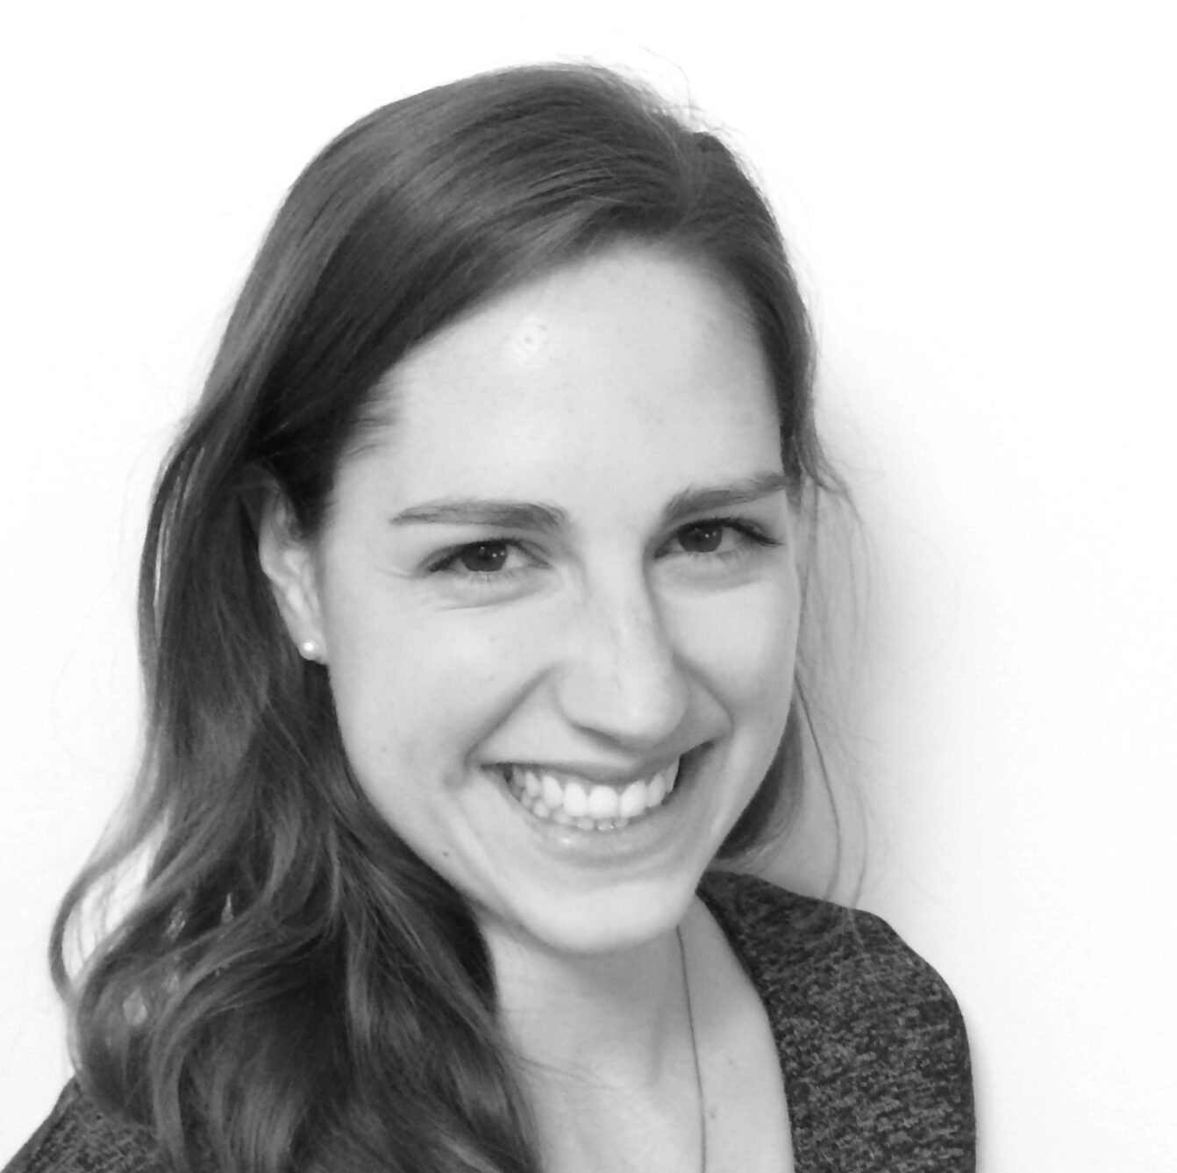
CONCURRENT STREAM
Why Patient Organisations’ Roles are Crucial to Driving Better Patient Outcomes
3 Nov 2022 | 10:00 EDT
Daphne Psacharopoulos
Board Member, ICHOM USA
Kellie Paich, M.P.H.
Global Director, Clinical Quality & Survivorship Movember, USA
Alan Balch, PhD
CEO, National Patient Advocate Foundation, USA
Ciara Drohan
Vice President and Honorary Secretary - The European Federation of Crohn's & Ulcerative Colitis Associations (EFCCA), Ireland
Theo Koster
Board of Advice Member, Linnean Group,
the Netherlands
Judit Takacs, PhD
Senior Manager, Partnerships and Engagement, Canadian Cancer Society

