Slide 1
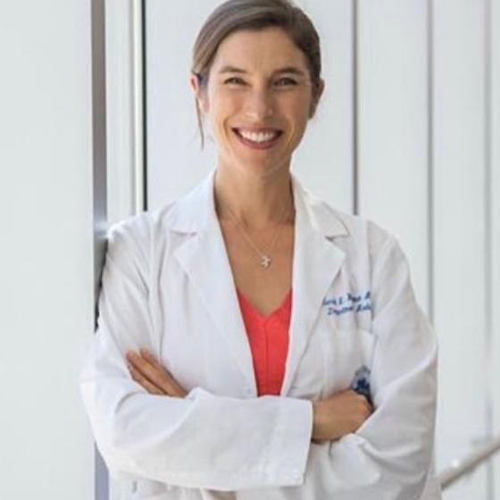
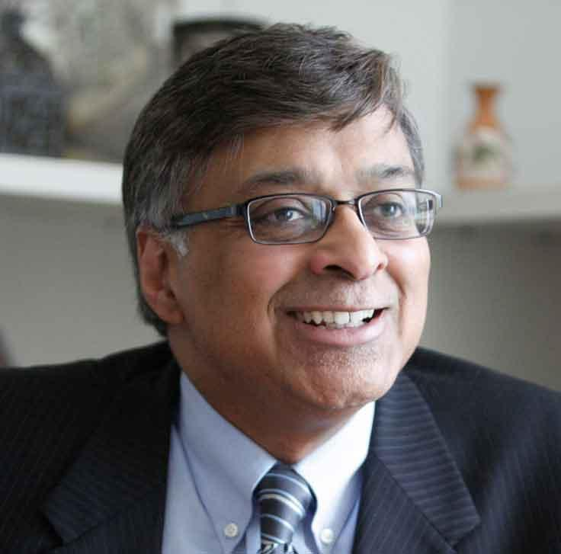
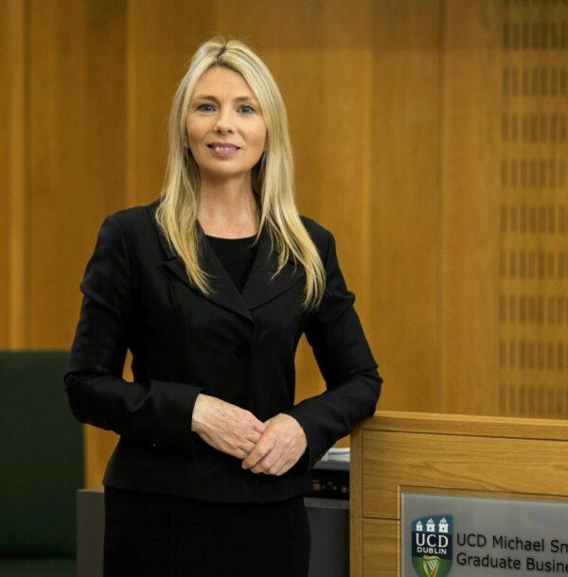
CONCURRENT STREAM
COST MANAGEMENT
Measuring and Managing Costs. Making Improved Outcomes Affordable for All Patient Groups
3 Nov 2022 | 11:10 EDT
Thomas H. Lee, MSc, MD, BA
Chief Medical Officer, Press Ganey Associates, Inc; Primary Care Physician, Brigham & Women's Hospital; Professor of Medicine (part time), Harvard Medical School; Professor, Department of Health Policy and Management, Harvard T.H. Chan School of Public Health, USA
Sarah Wakeman M.D.,
Medical Director of Massachusetts General Hospital’s Substance Use Disorder Initiative, Bridge Clinic
A.K. Nandakumar, PhD
Professor, The Heller School of Social Policy and Management; Academic Director, Global Studies Programs; Director, Institute of Global Health, Senior Advisor Office, Global AIDS Coordinator; Senior Advisor, USAID India Health Office
Gerardine Doyle PHD
Professor of Accounting and Taxation, Director, Michael Smurfit Graduate Business School, Associate Dean, University College Dublin

