Slide 1
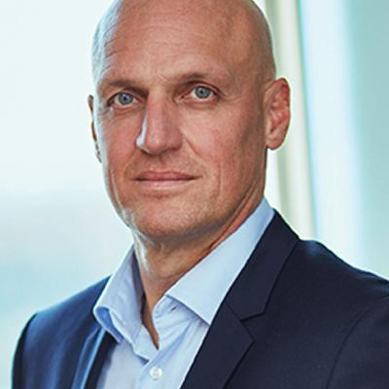
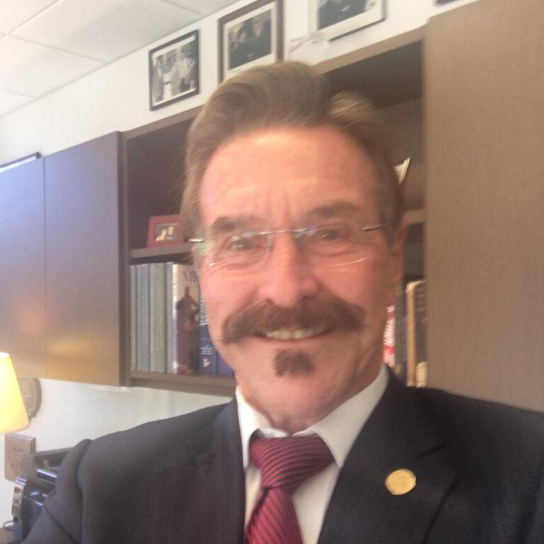
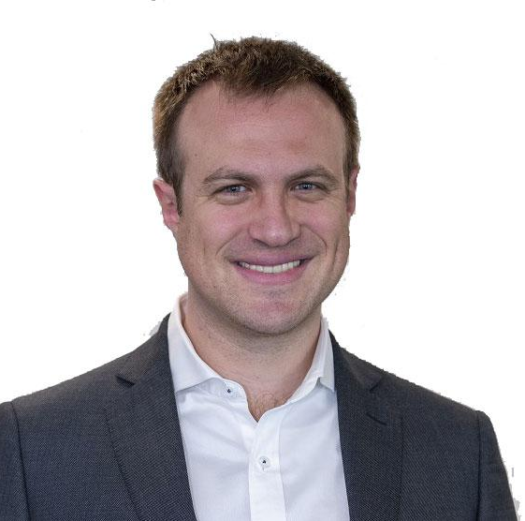
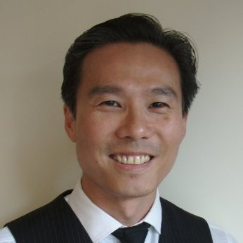
CONCURRENT STREAM
TECH, AI AND E-HEALTH SOLUTIONS
AI – Paradigm-Shifting Technology in Preventative Healthcare
3 Nov 2022 | 11:10 EDT
Dr Jan Kimpen
Chief Medical Officer, Philips
John C (Jack) Lewin, MD
Chairman, National Coalition on Health Care, Principal and Founder, Lewin and Associates LLC, Health Science Innovation and Policy
Dr. Ittai Dayan
Co-Founder & Chief Executive Officer, Rhino Health
Dr. L.Y.L. (Leonard) Wee
Assistant Professor, Maastricht University

