Slide 1
CONCURRENT STREAM
IMPLEMENTATION AND CHANGE MANAGEMENT
Keys to Successful VBHC Implementation – Pioneers’ Insights
3 Nov 2022 | 11:10 EDT
Prof. Martin Ingvar
Cofounder and Board Member - ICHOM,
Professor in Integrative Medicine - Karolinska Institutet, Sweden
Prof. Dr. Markus Graefen
Professor of Urology & Chairman - Martini Klinik, Germany
Jeffrey R. Balser MD, PhD
President and CEO, Vanderbilt University Medical Center,
Dean - School of Medicine, USA

Slide 2
Keys for Implementation of VBHC in a specialized Center
Thoughts from the Martini-Klinik - Prostate Cancer Center, Hamburg, Germany
Yourself
The team
The owner
a true and intrinsic motivation to know your outcomes
the believe that improvement is only possible when outcome is known
the understanding that only outcome measures allow to understand, display, discuss and track quality and development
A team that shares this idea
An open-minded trustful environment
The understanding that comparison of outcomes is beneficial for both, the group & each individual member of it
Outcome data are used to identify room for improvement and a culture of learning but not for punishment
The willingness for a long-tern investment that does not pay off directly
The understanding that VBHC is a smart investment since it builds the basis for quality control and an advantage to your competitors
Data measurement is the backbone for research, publications and cooperation's with the industry = a source for assuring sustainable success, promotion, business, and attractiveness as an employer
Notes:
I believ it is easier I a specilized center than a a more general setting since outcomes are more focused and asier to measure
‹#›

Slide 3
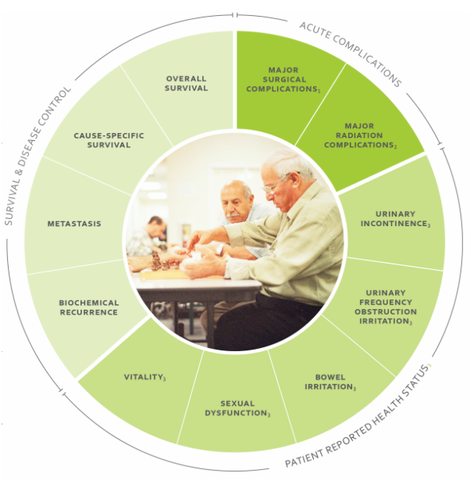
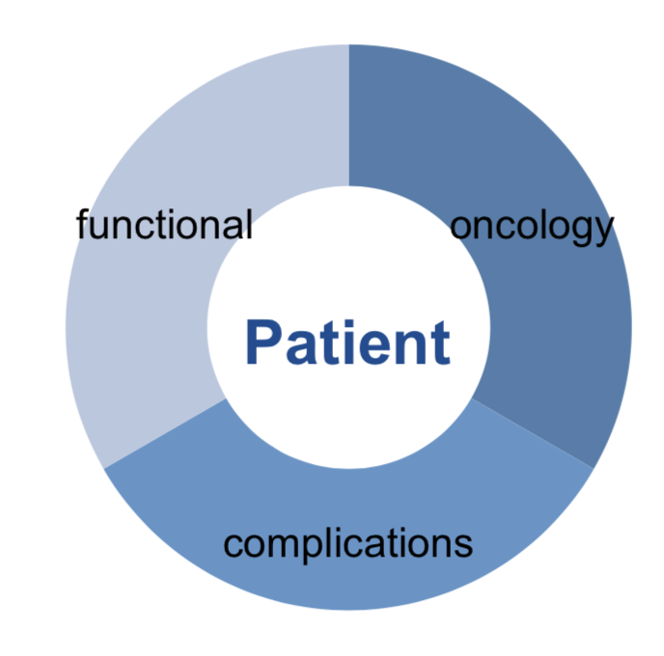
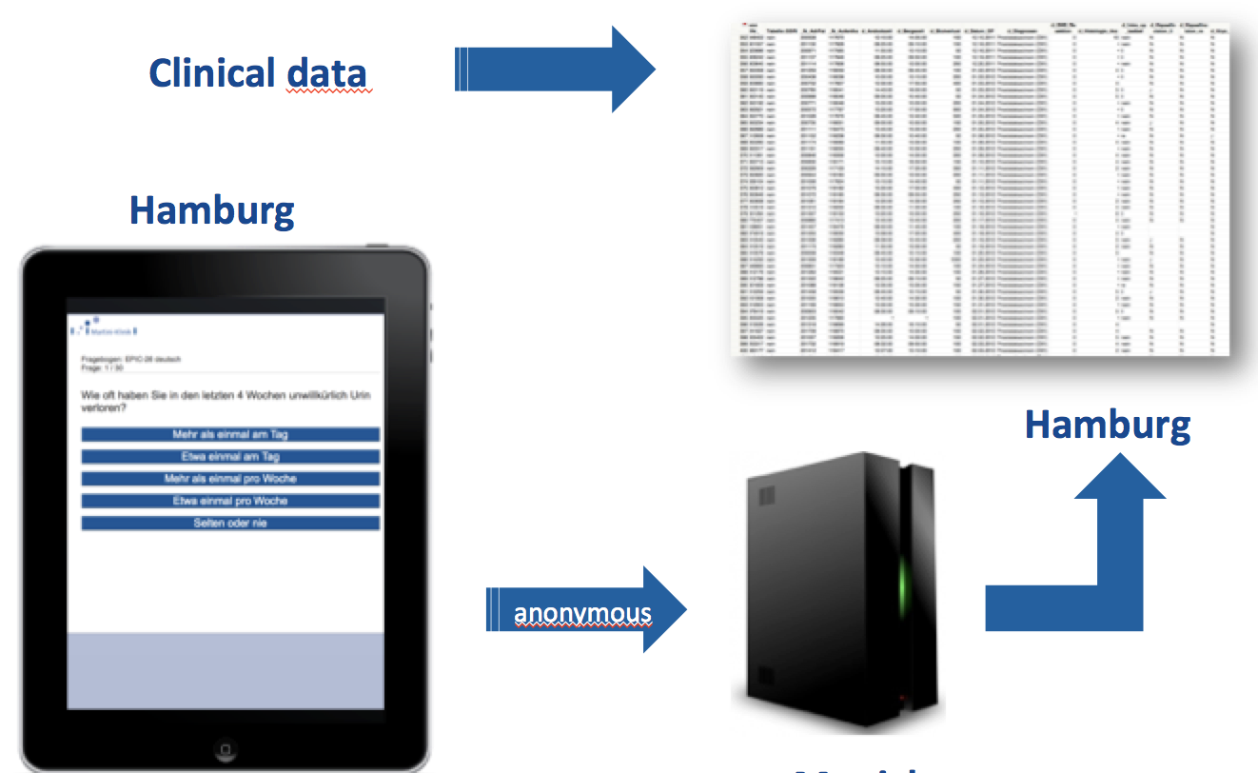
Keys for Implementation of VBHC in a specialized Center
Practical considerations
Standard Data Set
Consider before sharing what to do with the data and define goals
Motivate your patients since they understand, support and recognize the value of outcome measurement
Stay in touch!
i.e. annual research letter
Regular meetings, i.e. every half year
Discuss to what degree you share the data with
the public
your institution
the owner
Hardware, Software, Staff
Notes:
I believ it is easier I a specilized center than a a more general setting since outcomes are more focused and asier to measure
‹#›

Slide 4
Patient-Reported Outcomes Measurement at Vanderbilt University Medical Center
The Vanderbilt Patient-Reported Outcomes Measurement System (VPROMS) is an enterprise-level initiative to make the measurement of outcomes that matter to patients part of routine clinical care.
By seamlessly integrating patient-reported outcome measures into the electronic health record, VPROMS makes these data available to patients and clinicians during real-time clinical care as well as for quality improvement and research endeavors.
Key Milestones
2018
2019
2020
2021
2022
Discover
&
Plan
Conduct
Initial
Pilots
Small Scale Expansion
Roll Out
to remaining
Areas
Leverage data for Value-Based Health Care
650k+
34
Completed Questionnaires
30
7.5
minutes
165k
57%
Completion Rate
Geographical Sites in Tennessee
Unique Patients
Medical Specialties
Average Completion Time

Slide 5
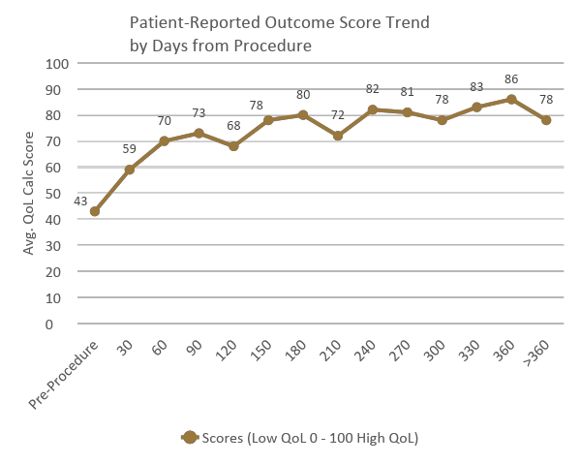
Stakeholder Engagement
Leveraging PROM Data
Bariatrics Pre & Post Surgery Quality of Life Scores
Acceptance of and willingness to actively support and participate in the initiative
Patients & Caregivers
Clinicians
Buy-In
Clinic Staff
Ambulatory Leadership
IT Leadership

