Slide 1
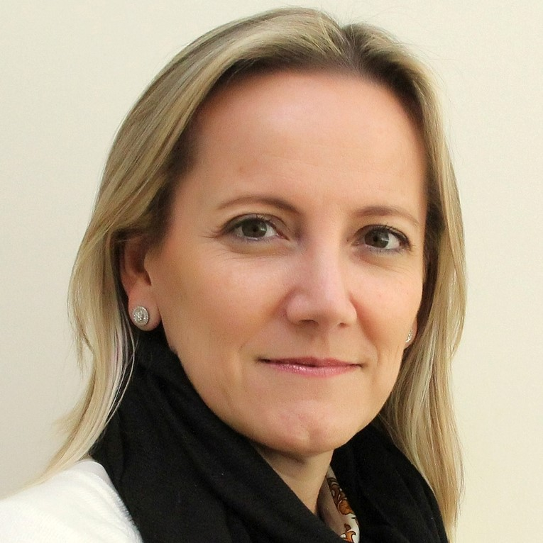
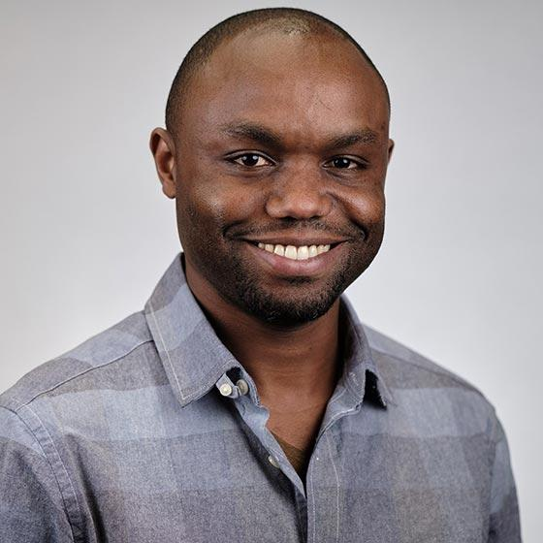
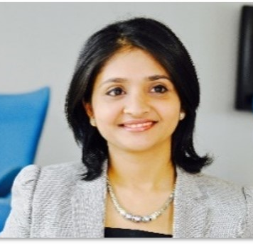
CONCURRENT STREAM
COST MANAGEMENT
TDABC Cost Management – Practical “How To” Session
3 Nov 2022 | 11:50 EDT
Thomas H. Lee, MSc, MD, BA
Chief Medical Officer, Press Ganey Associates, Inc; Primary Care Physician, Brigham & Women's Hospital; Professor of Medicine (part time), Harvard Medical School; Professor, Department of Health Policy and Management, Harvard T.H. Chan School of Public Health, USA
Dr. Carisi Anne Polanczyk
Chief of Cardiology Adjunct, Chief Medical Officer, Hospital Moinhos de Vento
Jean Claude Mugunga MD.,MS.,
Deputy Chief Medical Officer, Partners in Health (PIH)
Shirali Mewara
Project Lead, World Economic Forum;
VBHC Program Lead at Integrated Health Solutions, Medtronic

