Slide 1
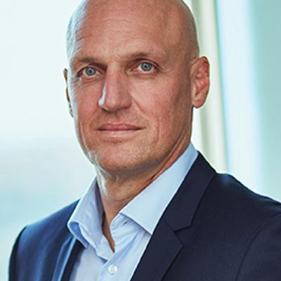
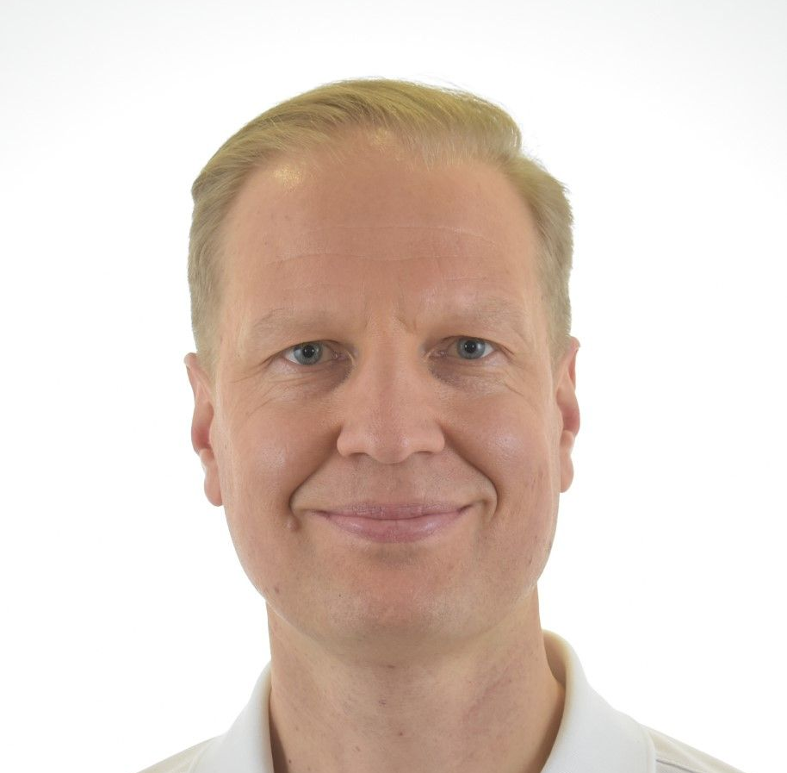
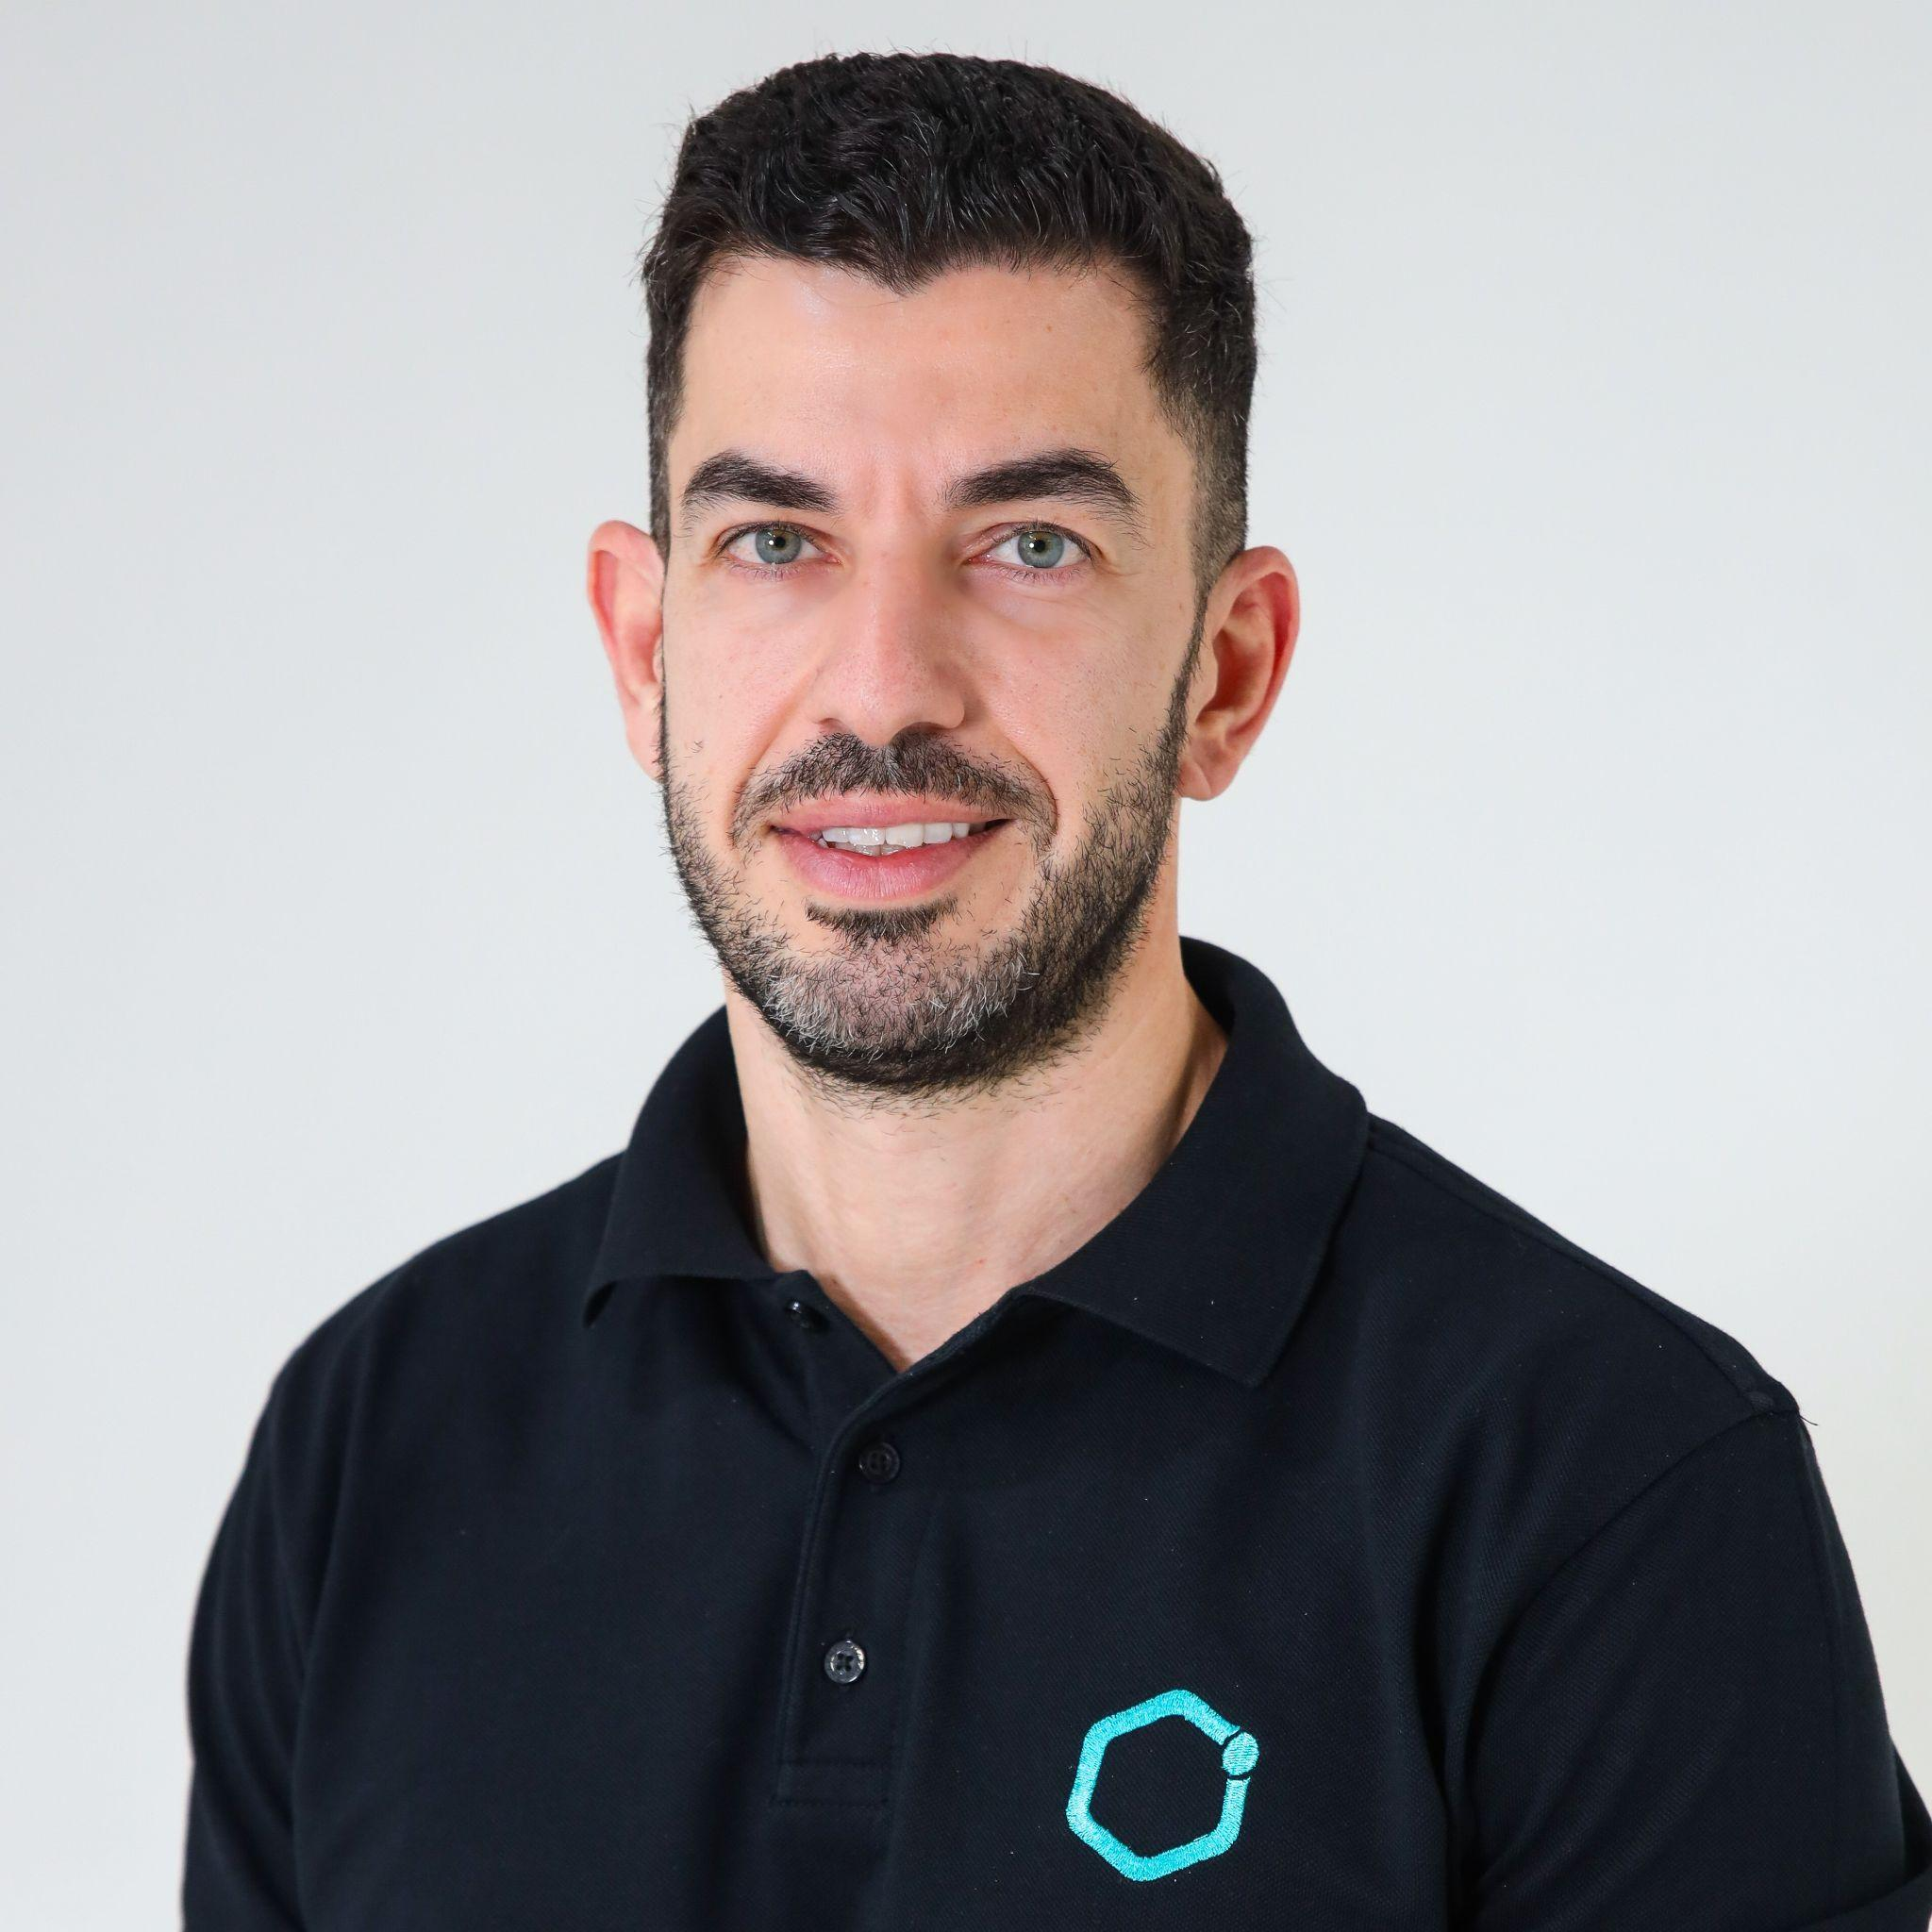
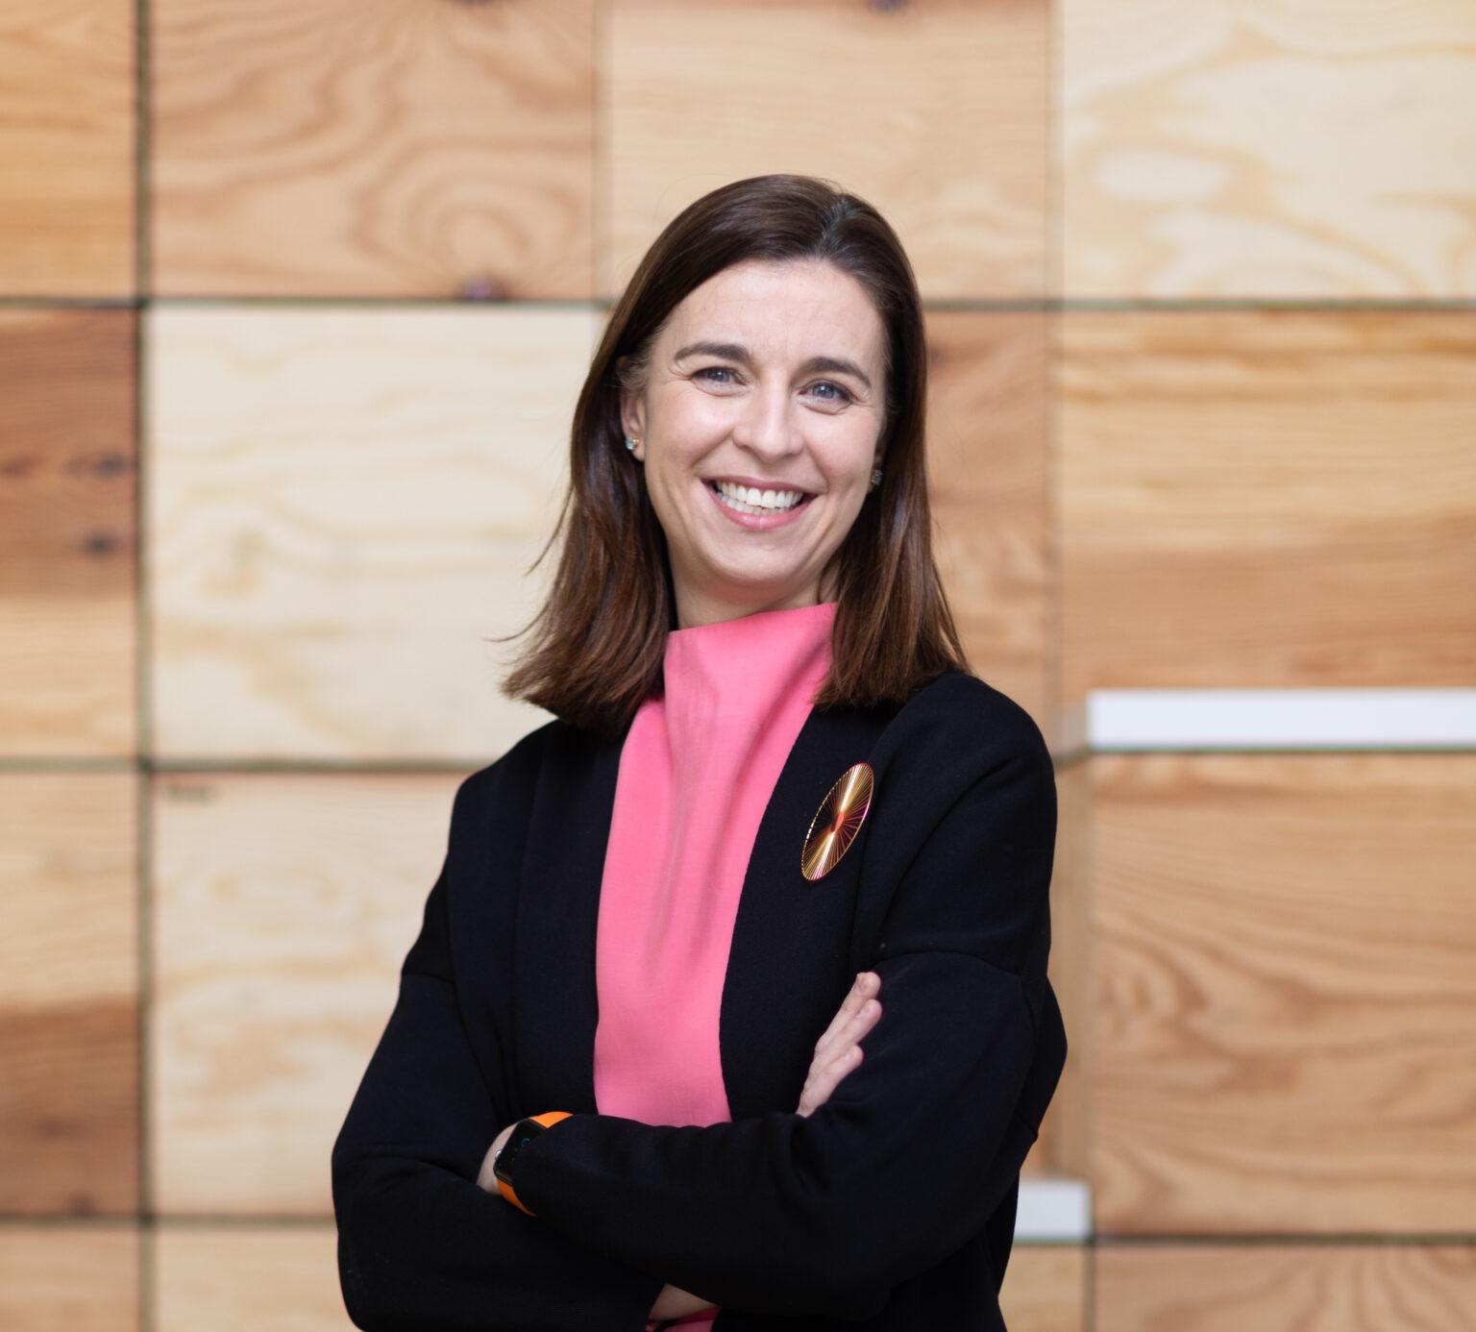
CONCURRENT STREAM
TECH, AI AND E-HEALTH SOLUTIONS
Post-Pandemic Role of Telehealth in VBHC
3 Nov 2022 | 11:50 EDT
Dr Jan Kimpen
Chief Medical Officer, Philips
Prof. Tuomas Brinck
Chief Innovation Officer, Orthopaedic Surgeon, Mehiläinen Hospitals Ltd, Finland
Dr. Ihsan Almarzooqi
Co-Founder and Managing Director, GluCare Health; Integrated Diabetes Center,
Dubai, United Arab Emirates
Dolores Paredes
Vice President Markets Strategy and Innovation, AIR LIQUIDE HEALTHCARE

