Slide 1
CONCURRENT STREAM
COST MANAGEMENT
ACS Thrive Project – Championing Quality Improvement in Surgery
3 Nov 2022 | 12:50 EDT
Frank G. Opelka, MD, FACS
Medical Director, Quality and Health Policy, American College of Surgeons
Anupam Dayal
Senior Program Manager, American College of Surgeons

Slide 2
THRIVE
TRANSFORMING HEALTHCARE RESULTS BY INVESTING IN VALUE & EXCELLENCE
Frank G Opelka, MD FACS
Medical Director
Quality and Health Policy
American College of Surgeons

Slide 3
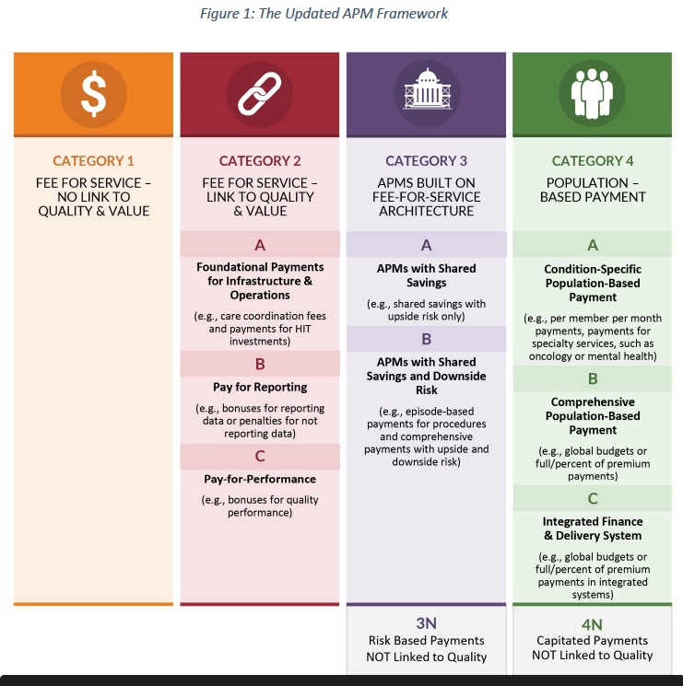
Payers’ Learning Action Network: APM
Alternative Payment Models
Payers use the LAN’s four categories for promoting alternative payment models based on quality and assumption of risk related to quality and price. These payment models range from FFS to an episode of care to cohort payments for a condition (such as cancer) to a total population assumed risk model.

Slide 4
Learning Action Network: Category 3/4 - -Episodes
Episodes of care

Slide 5
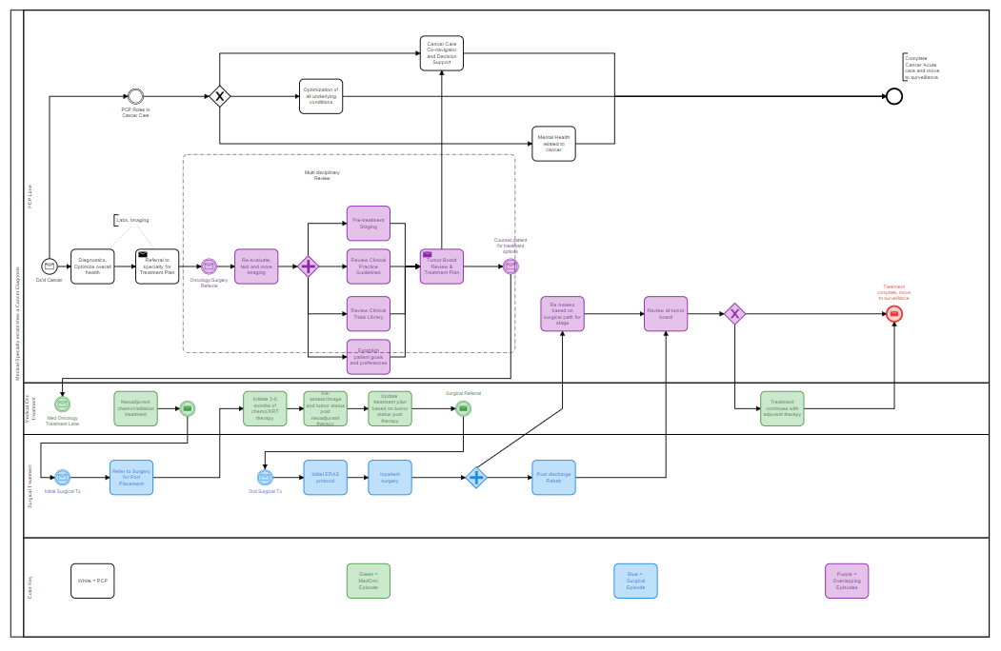
Modeling for Care Pathways, Quality & Price: An Oncology Example –
High level view of oncologic care and its associated services
Not intended to be all-inclusive (gaps in service list such as Pathology and Rad Onc)

Slide 6
Challenge of the intersects of clinical care models with payment models.
Multi disciplinary
Cancer Map :
This could be
Viewed as a
“Condition Episode”
Med Onc
Episode
Surg Onc
Episode
Payment could be FFS ot APM
LAN 3, or 4.
As a LAN 4, Cancer as a condition would exist as PMPM.

Slide 7
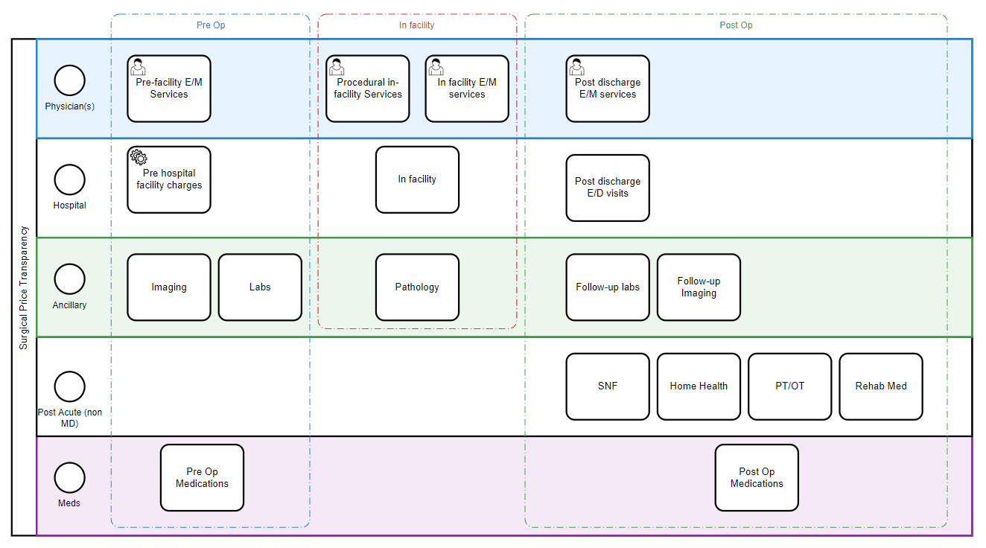
Drill-down list of services in pricing a surgical episode

Slide 8
THRIVE – a value expression
THRIVE project – a value-based project between ACS and Harvard Business School Institute for Strategy & Competitiveness
We provide a breakdown of price (based on Medicare actual rates) and production cost to provide that episode of care (preop + in facility + post discharge).
We risk adjust price using the CMS price risk calculator for MA Plans
We provide the institution with its payer mix.
THRIVE provides a surgeons the knowledge enabling them to contribute in their organization for value, quality, price and cost.
The participating sites are starting to learn how to leverage this knowledge for the benefit of the surgeon and their service line.

Slide 9
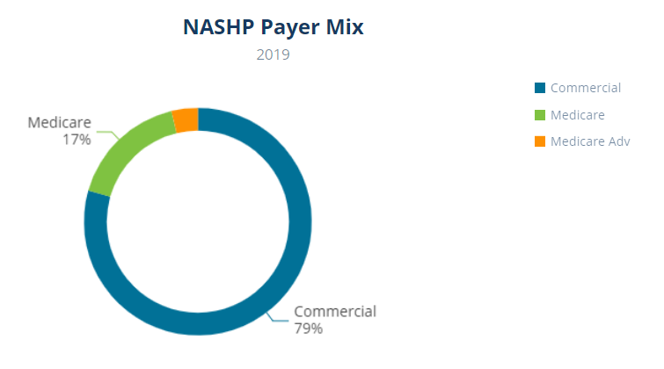
THRIVE: St Elsewhere Hospital Executive Summary- Colectomy for Cancer
Price and Volume
Regional Benchmark
THRIVE helps by framing the elements for Value-Based Healthcare
Framework:
Quality, Price, Costs to produce services, volumes and patient risk profile.
$29,738 Mean
Actual Allowable Price
Medicare
$21,739
Estimated Cost
Typical Patient
Risk Profile
High 55%
Intermed 20%
Low 25%
Value (Quality & Price)
ACS Quality Recommendations:
QVP Verification Program
NSQIP Safety Profile
Other Quality Metrics:
CMS Star Ratings
ICHOM Metrics
Cost Benchmark
ACS Collaborative Hospitals
Conclusions – Tertiary, Academic
Category | Rating
Volume | High Outlier
Price | High Outlier
Cost | High Outlier
Risk Profile | Mixed - High

Slide 10
THRIVE: St Elsewhere Hospital Patient Summary- Colectomy for Cancer
Price and Volume
Regional Benchmark
THRIVE helps by framing the elements for Value-Based Healthcare
Framework:
Quality, Price, Costs to produce services, volumes and patient risk profile.
$29,738 Mean
Actual Allowable Price
Medicare
Value (Quality & Price)
ACS Quality Recommendations:
QVP Verification Program
NSQIP Safety Profile
Other Quality Metrics:
CMS Star Ratings
ICHOM Metrics
Risk Profile
High 55%
Intermed 20%
Low 25%
Conclusions – Tertiary, Academic
Category | Rating
Volume | High Outlier
Price | High Outlier
Quality | Exceeds Top 10%
Risk Profile | Mixed - High

Slide 11
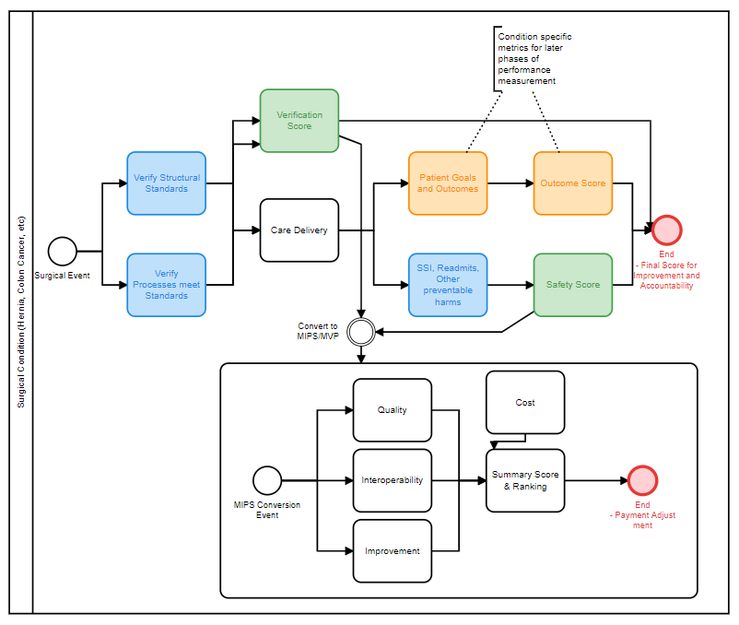
Quality Challenge
Informing patients and payers about quality requires a shift in thinking. Medicare does not measure and reward performance at the episode of care level.
To better inform patients about episodes of care means reframing the quality model used by payers to become more patient centric.
This depiction is the ACS framework for a MIPS conversion in episode based quality.
ACS-Think
CMS-Think

Slide 12
THRIVE
TRANSFORMING HEALTHCARE RESOURCES TO INCREASE VALUE AND EFFICIENCY
USING TDABC METHODOLOGY
Anupam Dayal, MPH
Senior Project Manager
American College of Surgeons

Slide 13
THRIVE
TRANSFORMING HEALTHCARE RESOURCES TO INCREASE VALUE AND EFFICIENCY
Our Team:
David B. Hoyt, MD
Frank G. Opelka, MD
Anupam Dayal, MPH
Mark Palmer, MBA
Alisa Azpeitia, CPA

Slide 14
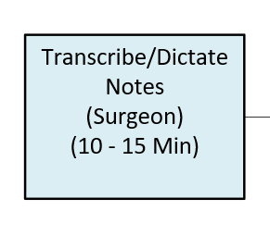
What is Time Derived Activity Based Costing (TDABC)? methodology used to calculate approximate cost
Who was involved in this Process Step?
What was the activity they completed?
How long did it take?
Surgeon
Transcribing/ Dictating notes
Approximately 10-15 minutes
Notes:
A methodology used as suggested by Dr. Bob Kaplan
THRIVE team took averages of estimated times when given a range for a particular task
is a tool which helps to understand the care pathway and the resources needed to implement that pathway. It is important to state that it is not intended to provide a contribution margin by using it against the price of care. It is a 'directional' tool that helps a care team assess their efficiencies, so we found as expected.

Slide 15
THRIVE Care Cycle Maps
THRIVE Pre-Op Process Example
THRIVE Surgery Example
THRIVE Inpatient Recovery Example
Notes:
Care Cycle defined by
CPT Codes- used to identify cases that qualify and retrieve i
For all care cycles– beginning at the Surgeon’s office after deciding that patient is a candidate for surgery through 90 days post recovery time.
Divided up in maps created first as a template and then tailored to the individual site based on the interviews with Surgeon Champion and the rest of the multi-disciplinary team
TDABC Mapping is not necessarily about the exact sequence of tasks many times, but instead about recording if the steps were actually completed. Capturing the steps whichever phase of care they may fall into actually provides insight into cost in each of those phases

Slide 16
THRIVE: The ACS Framework
Calculate modeled cost of care for 1 Typical patient
Modeled Cost is based in:
Aggregated Cost incurred by the organization
Cost relevant to a defined care cycle
De-identified data is used for any part of the calculation
Cost Data Resource Segments
Personnel
Consumables
Space
Equipment
The modality of the process maps afford calculation for complex decision-based streams in the care cycle
Notes:
Personnel
Space
Consumables
Equipment
No PHI asked for at any point
Care cycle is defined by CPT Codes and for the purpose of THRIVE starts in the surgeon’s office where the decision to perform surgery has already been made. The THRIVE process maps for a condition model care through 90 days of post-operative recovery period.
Cost Data Segments
Personnel – surgeons, nurses, lab techs, floor personnel– COLLECTED ON AN ANNUAL AGGREGATED BASIS
Consumables – staple loads, gowns, injectibles, OUT OF THE EMR BASED ON AN AVERAGE-TYPICAL CASE USAGE OVER THE CARE CYCLE
Space– traditional square footage +/- embedded items COLLECTED ON AN ANNUAL AGGREGATED BASIS
Equipment– if relevant, ex: Da Vinci robot COLLECTED ON AN ANNUAL AGGREGATED BASIS
For the sake of a modest sense of completeness the ACS TDABC model uses - and discuss the various inputs. It is important to stress that this is intended to be achievable on the common procedures and something to drive improvements - which means it has to be re-measurable as well as measurable at least once. If it is overbearing, it will never be used.

Slide 17
THRIVE TDABC Sites Analysis: Total Time and Total Cost: Example for Colectomy for Cancer
Map No. | Process | Minutes Used | Aggregate Total Costs ($)
1 | Pre-Work | 20 | $151
2 | Surgeon's Office Visit | 100 | $1,022
3 | Other Consults | 100 | $116
4 | POEC | 200 | $211
Subtotal Pre-Visit(s) |  | 420 | $1,500
5 | COVID Screening | 5 | $110
6 | Pre-Op Holding | 100 | $260
7 | Surgery | 1,200 | $9,489
8 | PACU | 60 | $276
9 | Inpatient Recovery | 2,900 | $2,865
Subtotal Intra Facility |  | 4,265 | $13,000
10 | Post Op-Call & F/U Visit | 200 | $500
Subtotal Post-Op Recovery |  | $200 | $500
 | Post Op-ER Visit |  | $2
 | Post Op-Admit Surgery | 175 | $448
Subtotal Post Op – Exceptions |  | 175 | $450
Total Production Time & Costs |  | 5,060 | $15,450
Notes:
Further drill down analysis provides cost by phase of care and includes information like nurse to patient ratios, cut-to-close times and ALOS.
This type of information affords hospitals to understand where the burden of cost lies– is it in levels of personnel in a given phase/step? Is it in the amount of time taking in a particular phase/step? is it a combination of both? Is it simply a ‘geographic’ difference– that we can take care of by standardizing for geography. What are the ways we can make our cost and work flow and responsibilities for different personnel less redundant/ more efficient?

Slide 18
THRIVE TDABC: Blinded Comparison Across Participating Sites
Notes:
Blinded Comparison between sites who have participated in the same episode of care. First attempt at benchmarking, very specific group, admittedly biased since all sites CHOSE TO be in this THRIVE pilot
This example shows that we’ve laid out each phase of the care cycle side-by-side and

Slide 19
THRIVE TDABC Deliverables for Participating Sites
Surgery Care Cycle Templates have been modeled for:
Colon Surgery - 10
Bariatric Surgery - 7
Breast Surgery - 3
Pancreatic Cancer Surgery - 1
ACS THRIVE has worked with Surgeon Champions and Multidisciplinary teams to:
Edit templated TDABC Process Maps in the selected Care Cycle
Calculate modeled cost based on the Process Maps

Slide 20
THRIVE TDABC – Future Steps
THRIVE Data Analytics for different decision makers:
Executives in the C-suite
Business/ Operations
Patients
Data Analysis includes:
Price comparison against National averages and against regional averages
Modeled Cost comparison against THRIVE sites
Payor-mix at the hospital
Surgeon triggered Price and Surgeon- related modeled cost
Notes:
It takes refinement by the end-users, which is where we are today. We are showing the results to the pilot sites and attempting to get their feedback as to what parts are actionable and reusable in future attempts to remeasure.

Slide 21
VALUE IS AN ENDLESS JOURNEY. JOIN US.

