Slide 1
CONCURRENT STREAM
IMPLEMENTATION AND CHANGE MANAGEMENT
Abstract Presentation. Implementation of a Multidisciplinary Personalized Endometriosis Management Program in French Primary Care Clinics
3 Nov 2022 | 13:30 EDT
Dr Alba Nicolas-Boluda
Head of Value Based Health Care and Head of the Paramedical Unit, One Clinic

Slide 2
Implementation of a multidisciplinary personalized endometriosis management program in French primary care clinics
Alba Nicolas-Boluda, Marc Even, Laura Contente,
Arnaud Fauconnier, Jérôme Bouaziz
Boston, November 3rd 2022

Slide 3
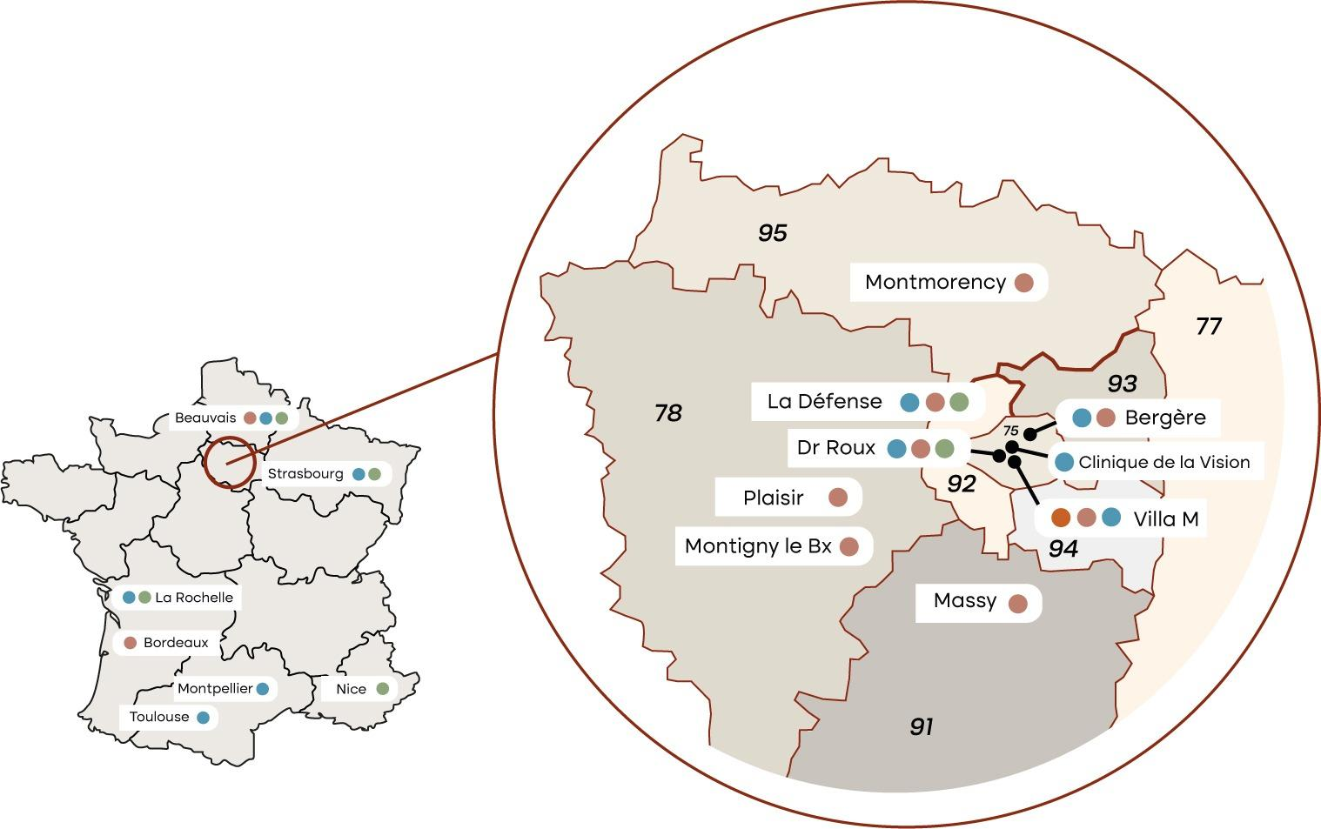
Women’s health
General practitioner
Ophthalmology
Cardiology
One Clinic proposes a complete care pathway for patients including virtual health care, on site lab testing and surgery in partnering hospitals and clinics.
One Clinic’s 3 founding pillars:
Innovation
Value-Based Healthcare
Reinforced partnerships with hospitals
Notes:
I work at One Clinic, a French primary care provider specialised in women’s health, General medicine, ophtalmology and cardiology. One Clinic proposes a complete care pathway including a virtual health care, we believe that the combination of virtual and « in person » care is key to deliver optimal health services, we have on site lab testing, patients do not need to seek a laboratory to get their tests and also we have strong partnerhsips with hospitals and clinics, that means that even if we do not have on site ORs, patients are operated by their doctors in one – its our way of ensuring the continuum of care.
We are present in mostly in the parisian region, but as you can see we are expanding all over France.
The project I am presenting today has been conducted by the women’s health team since it is focused in a up until now, not very known disease called endometriosis.

Slide 4
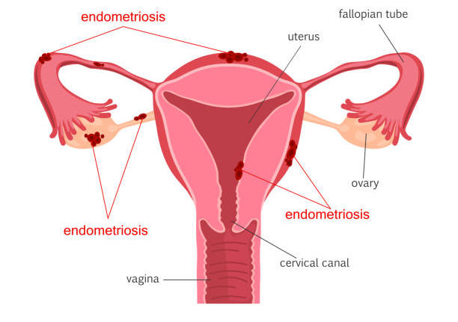
Endometriosis, still a challenge
Heterogeneous symptomatology including:
Pelvic Pain
Dysmenorrhea
Dyspareunia
Intestinal disorders
Urinary problems
Infertility
Challenges in endometriosis care :
Big variability of symptoms from one patient to another
The perception of the disease can be significantly different from patients' and physician’s perspective.
Endometriosis-related burdens: physical, mental, social, financial…
Notes:
Endometriosis is a disorder in characterized by presence of endometrium-like tissue outside the uterus, that impacts the reproductive and general health of women during their life. This disease has no cure for now. Multiple symptoms are associated with endometriosis, including pelvic pain, dysmenorrhea, dyspareunia, intestinal or urinary problems, and infertility.
Worldwide, the average time to diagnosis after the onset of symptoms is 7 years.
In addition, the lack of successful long-term therapeutic approaches to manage endometriosis-associated symptoms further complicate clinical management.
The main challenges related to endometriosis care are the fact that there is a big variability of the symptoms from one patient to another.
The perception of the disease can be significantly different from patients’ and physician’s perspective as there is not always a correlation between the clinical classification and symptom severity.
As it is the case in other chronic pain conditions, endometriosis-related pain can lead to significant physical, mental, relationship and even financial burdens.

Slide 5
A multidisciplinary coordinated model of care
A multidisciplinary coordinated model of care
Conventional model of care
Gynecologist
Osteopath
Psychologist
OR
hands-on therapy used to maintain or restore the mobility of tissues
Pelvic pain
Anxiety, depression and self-esteem
Disease related mental/social burden
Gynecologist
General
practitioner
Physiotherapist
Nutritionist
Pelvic floor physical therapy
Dyspareunia
Urinary dysfunctions
Anti-inflammatory diet
Digestive dysfonctions
Notes:
In the conventional model of care, in France, but I think it is also the case in many other countries, patients are mainly taken care by physician (general practitioner or gynecologist), sometimes not well prepared on how to manage this disease because of lack of training.
Most women with endometriosis live with pain and its consequences.

Slide 6
A multidisciplinary coordinated model of care
A multidisciplinary coordinated model of care
Conventional model of care
Gynecologist
Osteopath
Psychologist
OR
hands-on therapy used to maintain or restore the mobility of tissues
Pelvic pain
Anxiety, depression and self-esteem
Disease related mental/social burden
Gynecologist
General
practitioner
Physiotherapist
Nutritionist
Pelvic floor physical therapy
Dyspareunia
Urinary dysfunctions
Anti-inflammatory diet
Digestive dysfonctions
Notes:
What we propose is a multidisciplinary coordinated model of care that not only includes the gynecologists but also a team of paramedics including psychologists that can help patients with the management of the disease related mental/social burden, nutritionists that can introduce patients to anti-inflammatory diet and other changes at the nutrition level can improve digestive dysfunctions and related pain, physiotherapy, pelvic floor physical therapy can improve dyspareunia and urinary dysfunctions and osteopaths that can help with pelvic pain.
As I told you previously, there is a huge variability in the symptomatology of endometriosis from patient to patient, and what work for one does not work for another. That is why we considered that the use of PROMs was key to determining what was what each patient really needed.

Slide 7
A patient-centered endometriosis pathway
The objective of this 6-month pathway is to give the patient the keys to improve their life with endometriosis
The gynecologist recommends the patient to integrate the pathway
Inclusion criteria :
patients of legal age (> 18 years old),
diagnosed with endometriosis,
presenting severe pain related symptoms (pelvic pain, dyspareunia, dysmenorrhea, intestinal or urinary problems…).
Notes:
The starting point of the pathway is the gynecologist, he/she « prescribes » the pathway to the patient according to inclusion criteria that we defined – patients of legal age, it does not mean that we do not take care of teenagers, but further procedure is needed because we need parental consent. For simplicity I did not include them in this presentation., diagnosed wiht endométriosis and with sever pain related symptoms, which is a big % of patients with endometriosis, but it is possible to have endometriosis and not suffer from pain.

Slide 8
A patient-centered endometriosis pathway
The objective of this 6-month pathway is to give the patient the keys to improve their life with endometriosis
The gynecologist recommends the patient to integrate the pathway
Patient Reported Outcome Measures
Endometriosis Health Profile (EHP-5)
ENDOPAIN-4D
Work Productivity and Activity Impairment (WPAI)
Other symptoms and life habit related questions.
Patient fills in the PROMs (EHP-5, ENDOPAIN-4D) + other questions (nutrition, drug consumption..)
PROMs were selected in an international Delphi Study
Notes:
Next, we measured PROMS. Since ICHOM has not yet created a standard set for endometriosis, and at the time when I enquired it was not on the pipeline, we conducted an international Delphi study with specialists and patient representatifs to determine a short list of PROMs that were feasible and relevant in endometriosis, that included the Endometriosis Health Profile to measure the impact in quality of life, ENDO-Pain 4D that measures different dimensions of pain, the Work Producitivity and Activity Impairement and we added other questions on pain killer consumtiona nd other life habit related questions. This project was presented in one of our posters that you can check out for further details.

Slide 9
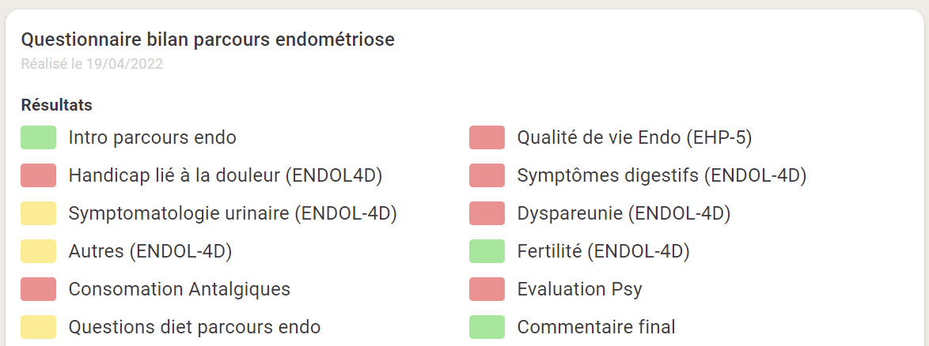
A patient-centered endometriosis pathway
The objective of this 6-month pathway is to give the patient the keys to improve their life with endometriosis
The gynecologist recommends the patient to integrate the pathway
Definition of a personalized care pathway based on patient needs
After 3 months patient evaluation (PROMs) + interview with care manager - care pathway readapted according to patient needs
Interview with care manager to determine (based on PROMs) the needs of the patient
Patient fills in the PROMs (EHP-5, ENDOPAIN-4D) + other questions (nutrition, drug consumption..)
Nutritionist
Psychologist
Physiotherapist
Osteopath
Group workshops (sophrology for pain management, adapted exercise for endometriosis, discussion groups…)
Notes:
Next, the patients are assigned a « care manager » that conducts and interview based on the PROMs and determines with the patient a personalized care pathway based on patients’ needs with a 3 month objectif. This pathway can include group workshops and individual consultations with the different paramedics according to the patients needs. 3 months later we evaluate again the patient’s condition with PROMS, followed by an interview witht eh care manager and the pathways ia readapted according to patient needs. This pathway is a 6 month pathway because the objetive is to give the patient the keys to improve their life with endometriosis. Endometriosis is a chronic disease with no cure. It is possible that some patients need longer that 6 months and in that case if their doctor agrees it can exceed 6 months of course, but it is really case based.

Slide 10
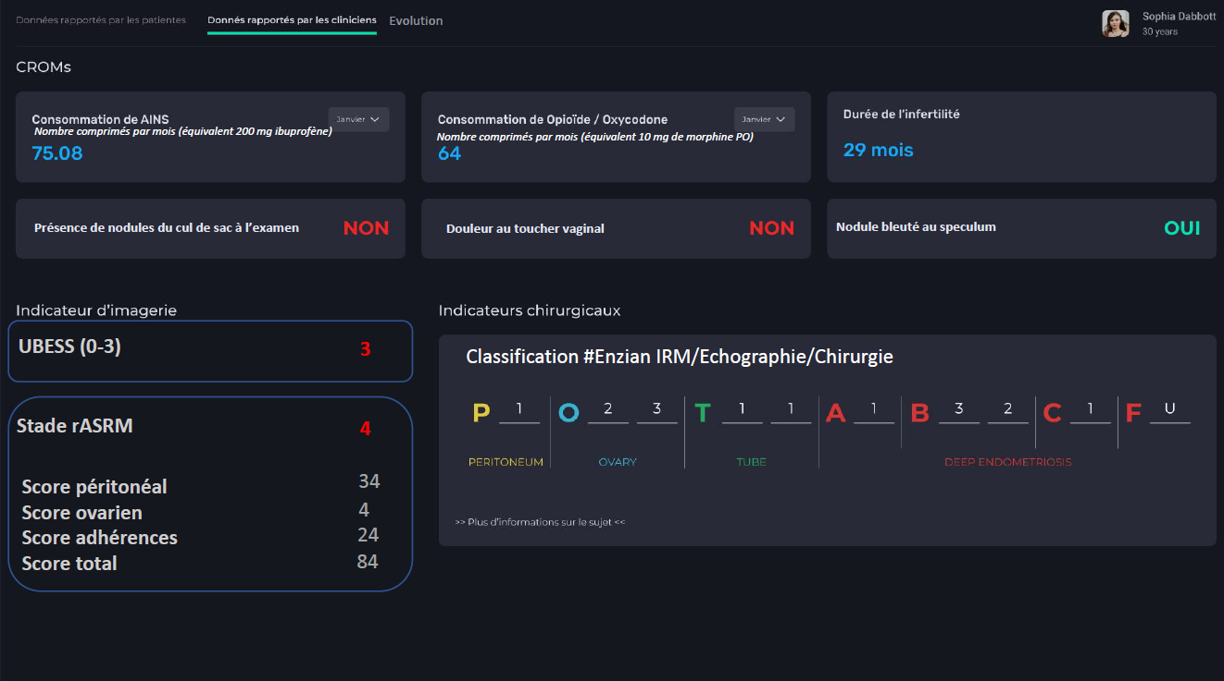
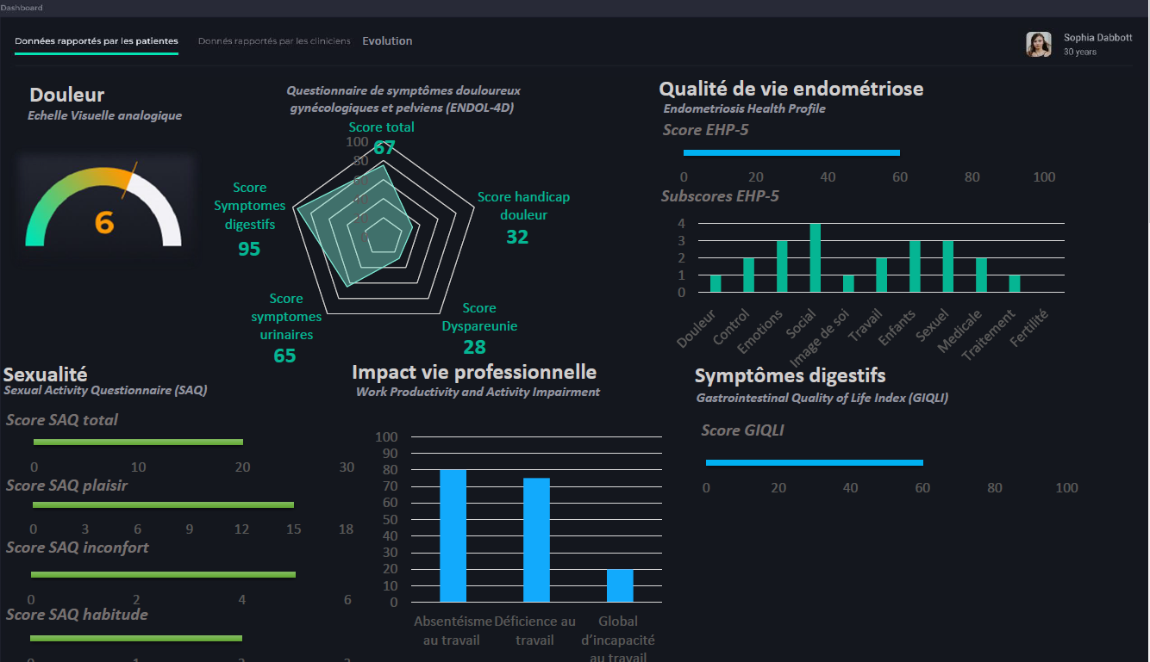
The Dashboard as a tool to personalize the patients’ pathway
The 1st version of our dashboard
The upgraded version of our dashboard, codesigned with patients and the medical team
Quality of life
Psychologic impact
Pain-related disability
Dyspareunia
Fertility
Urinary symptoms
Digestifs symptoms
Analgesics consumption
The combination of CROMs and PROMs in a same dashboard allows having a complete view of the patient’s health status, which allows the personalization of the care pathway to her specific needs.
Notes:
So you may be wondering, how are raw PROM data turned into actionable information that can be used by the care coordinators?
In order to personalize the patient pathway to her specific needs based on the PROMs we have built a dashboard for the medical team.
We started very simple, with a green yellow red color coded dashboard. This allowed the care coordinator have an initial view of the patients health status concerning her endometriosis and fine tune the questions in order to determine the patient needs.
We have now built an upgraded version of the dashboard that we have built with the collaboration of both patients’ and the medical team, if you’re interested on knowing more on how we built the dashboard, you can check out our second psoter in the abstract gallery.

Slide 11
Preliminary results
No change
Improvement
Degradation
Between December 2021 and June 2022
Quality of life (EHP-5)
73%
5%
21%
157
Pain-related impairment (ENDOPAIN-4D)
68%
15%
15%
Patients joined the program
Digestive symptoms (ENDOPAIN-4D)
63%
0%
36%
30
Patients have concluded the program
Dyspareunia (ENDOPAIN-4D)
47%
16%
37%
(19%)
Urinary symptoms (ENDOPAIN-4D)
63%
15%
13
21%
Patients have abandoned the program
Pain (ENDOPAIN-4D)
73%
0%
26%
(8%)
114
Patients are still on the program
Work impairment (WPAI:GH)
63%
21%
15%
(73%)
Notes:
We launched the program as it is now, in December 2021.
Between December 2021 and June 2022, when I collected the data to write the abstract, 157 patients joined the program – today have more than 200.
30 patients finished the program, 13 have abandoned the program and 114 were still on the program
Preliminary results on the first 30 patients show that it does help, more than 60% of patients report an improvement of their quality of life, overall pain, pain-related disability and work impairment (absenteeism/presenteeism)

Slide 12
Lessons learned
Demonstrated the feasibility of contemplating an alternative patient centered care for pain related chronic diseases
Demonstrated the use of PROMs in routine clinical practice at the individual patient level throughout the care pathway to finetune and adapt to the patients’ needs
Notes:
Endometriosis is a painful and complex disease that is challenging to both patients and care providers. Our insights from the establishment of a multidisciplinary personalized endometriosis management program demonstrates the feasibility of contemplating an alternative patient centered care for pain related chronic diseases. In addition, we demonstrate the utility of PROMs in routine clinical practice at the individual patient level during its care pathway. Since PROMs can identify issues that are not easily brought up in consultation and provide an opportunity for health care professionals to discuss patients' expectations of a given treatment and potentially identify incompatibilities or unrealistic expectations

Slide 13
Lessons learned
Demonstrated the feasibility of contemplating an alternative patient centered care for pain related chronic diseases
Demonstrated the use of PROMs in routine clinical practice at the individual patient level throughout the care pathway to finetune and adapt to the patients’ needs
Next steps
Further evaluate the effect of this multidisciplinary program in opioid/analgesics consumption, frequency of emergency room visits or even the effect on the rate of surgical intervention.
Measure the denominator of the value equation, the “cost” – what is the appropriate costing method?
Implementation in other regions.
“Macro” analysis : benchmarking between the different centers and creation of learning communities
Use this program as a model to create other pathways in chronic diseases such as long COVID -19 or heart disease.
Notes:
Next steps include further evaluation of the effect of the multidisciplinary pathway in other KPIs like opioid/analgesics consumption, frequency of emergency room visits or even the rate of surgical interventions. Also finetuning the analysis to include case mix adjustments, in the presented prelimlinary results we did not distinguished between patients that were under hormonal treatments from those that had undergone surgery – there is still work to do!
Another next step is the measurement of the denominator of the value equation, the “cost” and what would be the appropriate costing method
For now we have conducted this in 2-3 centers in the Parisian region, we would like to extend it to other centres.
Also, we have demonstrated the use of PROMs at the “micro”/patient level, we now need to take it to the ‘macro’ level to its use in benchmarking between different centers and sharing best practices
And to finalize we will use this programmed a model to create other pathways in chronic diseases for example long COVID 19 or heat diseases.

Slide 14
Thank you
alba.nicolas-boluda@one.fr
oneclinic.fr

