Slide 1
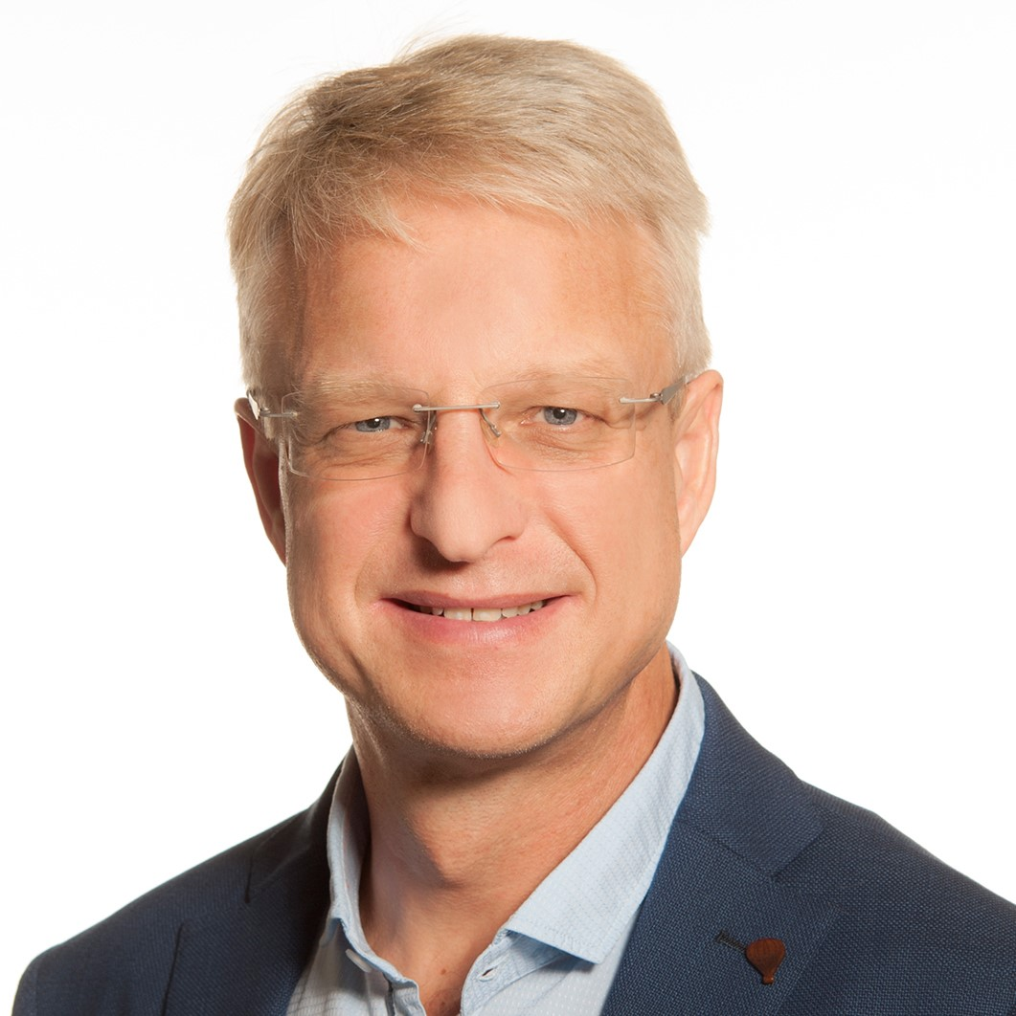
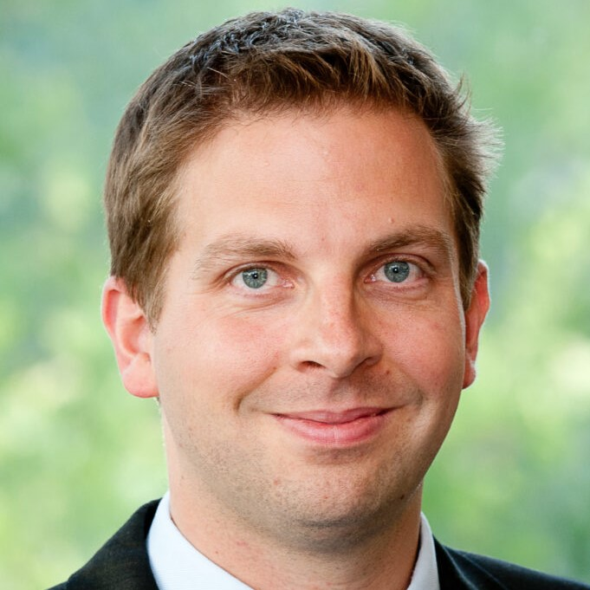
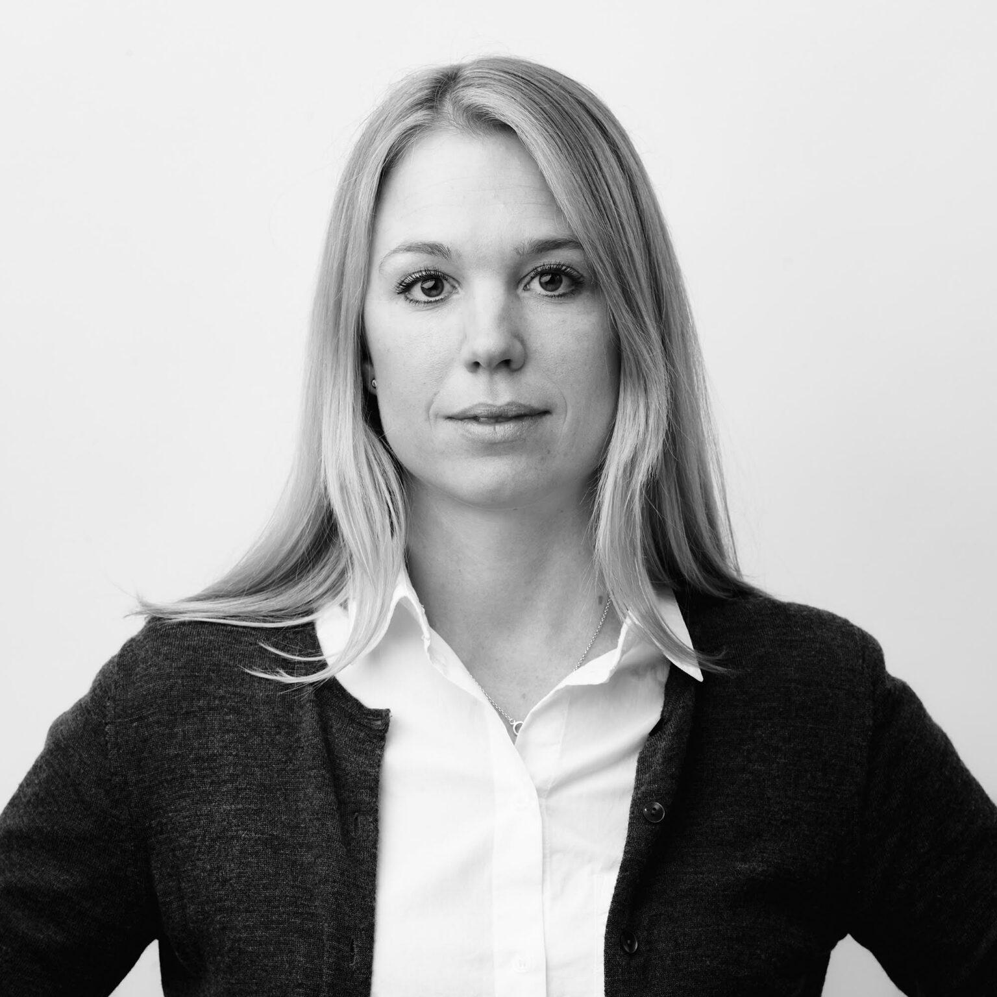
CONCURRENT STREAM
Collaborative Learning – What is Stopping Us?
2 Nov 2022 | 14:40 EDT
Dr. Zofia Das-Gupta
Outcomes Research Director, ICHOM, UK
DR. Florian Rueter, M.D
Head Quality Management and Value Based Healthcare, University Hospital Basel
L.B. (Linetta) Koppert
Associate Professor, Surgical Oncology, Clinical Epidemiologist, Erasmus MC Rotterdam,
the Netherlands
Prof. François Duhoux
Associate Head of Clinic, Cliniques universitaires Saint-Luc, Belgium
Maria Björkander
Principal & Head of Product Development, Clinical Outcomes, LOGEX

Slide 2
First European scale network for health outcomes data
Government
Integration
EHR system
Healthcare professionals
Providers
Patients & patient organisations
Remote access
Patient- generated data
Pan-European H2O
Austria H2O
Germany H2O
Netherlands H2O
Spain H2O
Regulators & HTA agencies
Patients
Academia & Research
Federation
Disease registry
Life Sciences Industry
Observatories will initially collect outcomes for three diseases:
Diabetes · IBD · Cancer
Additional sources
www.health-outcomes-observatory.eu

Slide 3
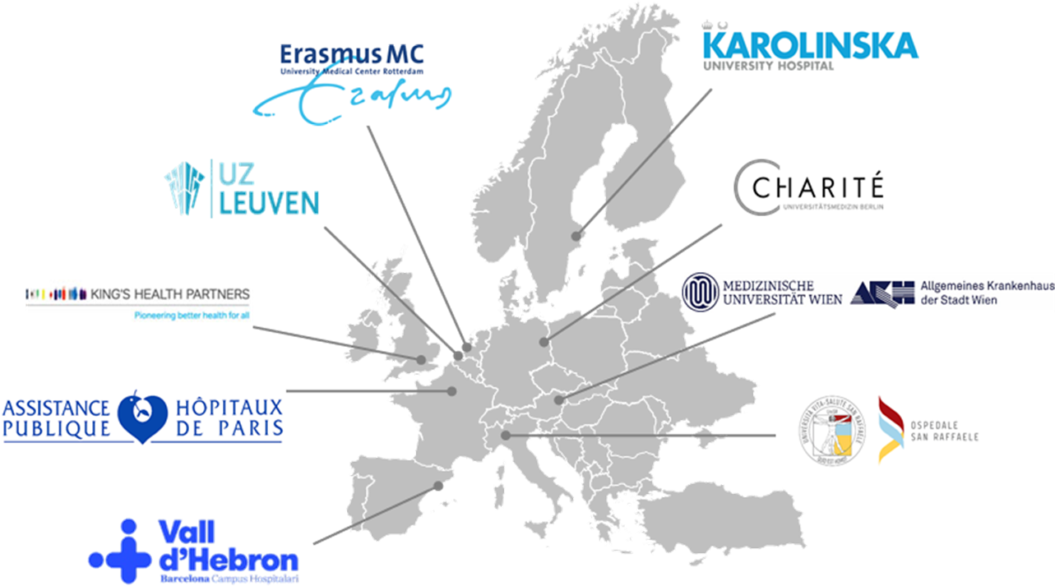
A European initiative of public-private-partners including ICHOM
to establish Observatories as legal entities and running services and in three disease areas (diabetes, IBD, cancer)
to collect and share data on PROMs and other health data in a standardized way
to empower patients with digital tools to better manage their health, report their health outcomes, and remain in control of their data
to improve the dialogue between patient and doctor, so that patients receive better care & improve healthcare professional’s access to data to inform their clinical decisions
www.health-outcomes-observatory.eu

