Slide 1
MomCare
A digitally enabled VBHC model providing access to quality care
Presented by Nicole Spieker

Slide 2
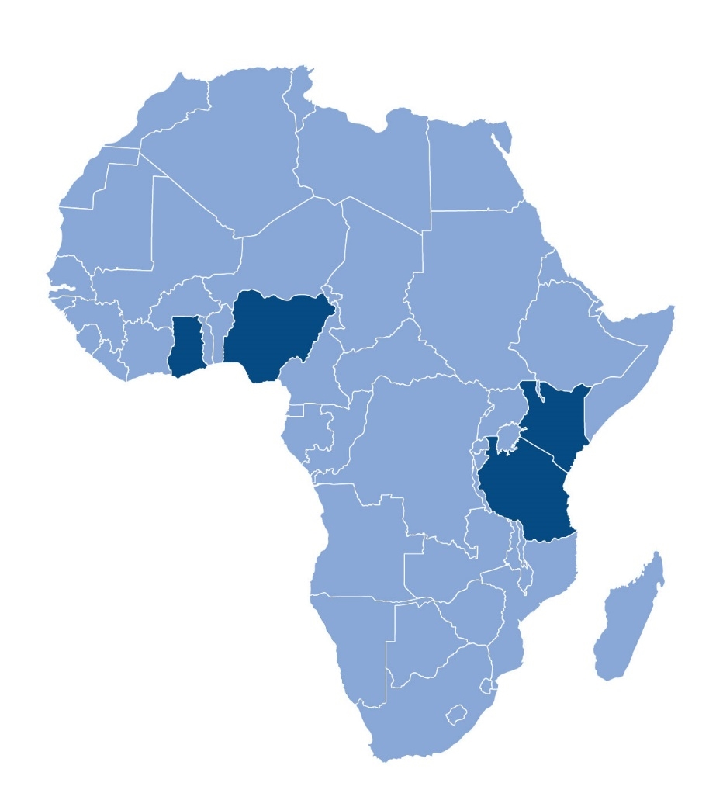
Introducing PharmAccess │ A holistic approach towards healthsystems
Access to finance with Medical Credit Fund
Research & analysis
Providing loans to health SMEs in partnership with local banks
Measure the impact of our work to build proof of concept and advocate scale up
Insurance
Support states in realizing Universal
health Coverage ambitions using
(mobile) technology
Quality improvement
with SafeCare
Digital innovations
Independent standards measuring quality of care and enabling benchmarking
Technological innovation is at the heart of what we do - offering a new model to make healthcare affordable and accessible

Slide 3
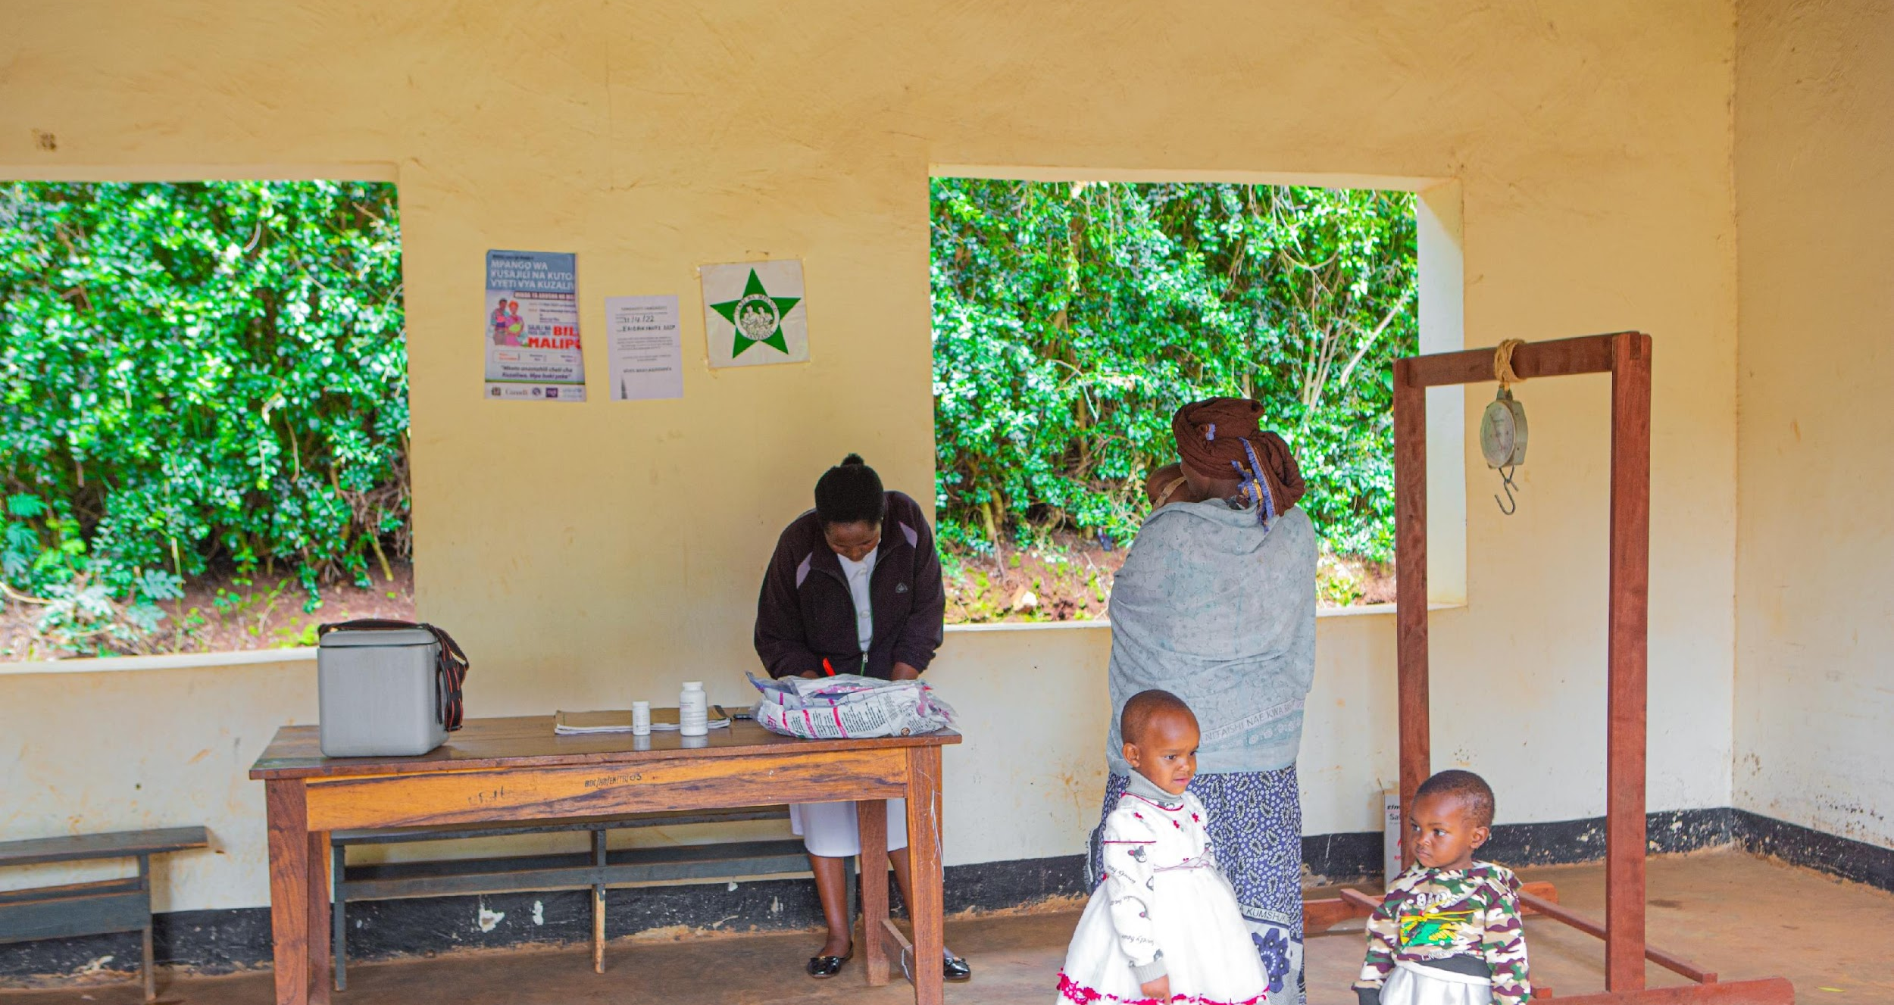
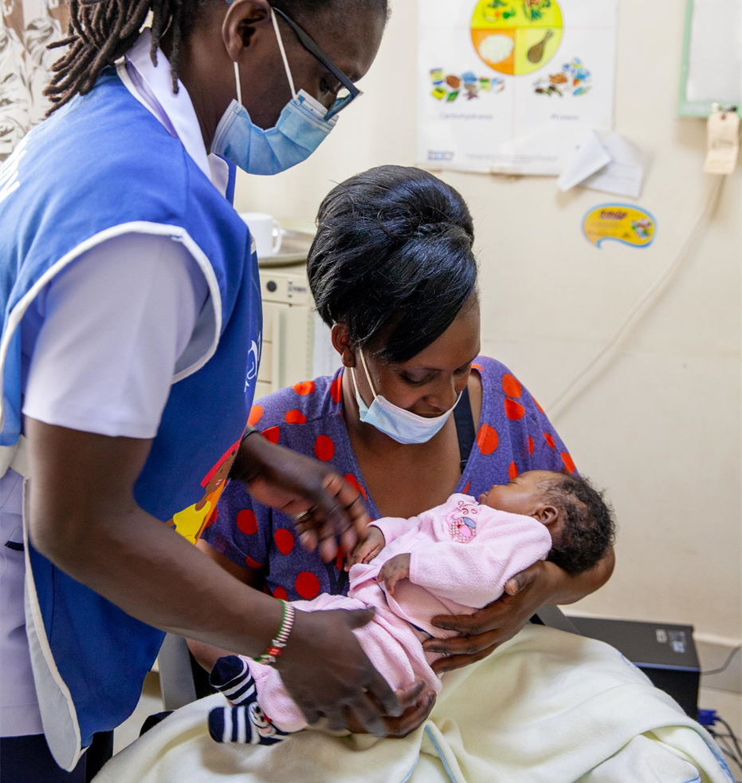

Slide 4
MomCare | Over the last 3 years, PharmAccess and partners have tested a digital care model, powered by mobile communication
A care bundle:
“A set of interventions that – used together – significantly improves health outcomes”
Key principles of digital development:
Centered on outcome for the patient
Starting with a minimum viable product, using a progressive development approach
Using evidence from data to prioritize
Quality support
SafeCare standards
Training, workshops
Network management
Journey tracking
Transparency on quality of journeys
Behavioral nudges
Analytics & research
Quality & Access
Clinical
Experience
Economic
Mobile wallet
Full financial cover
Conditional payments for providers (“smart contracts”)
Timely payment

Slide 5
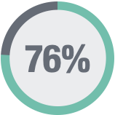
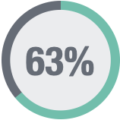
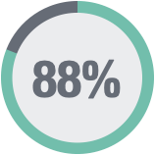
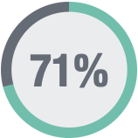
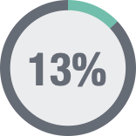
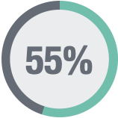
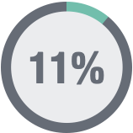
MomCare| Creating a full journey picture from multiple data sources
End of journey
Delivery
Enrolment
ANC 3
ANC 4 + Birth plan
PNC
PNC Immunizations
ANC 1
ANC 2
Platform support
Reminders
Payments
Mother feedback
Journey data
Platform combines data from different sources to create an integrated view of the patient journey

Slide 6
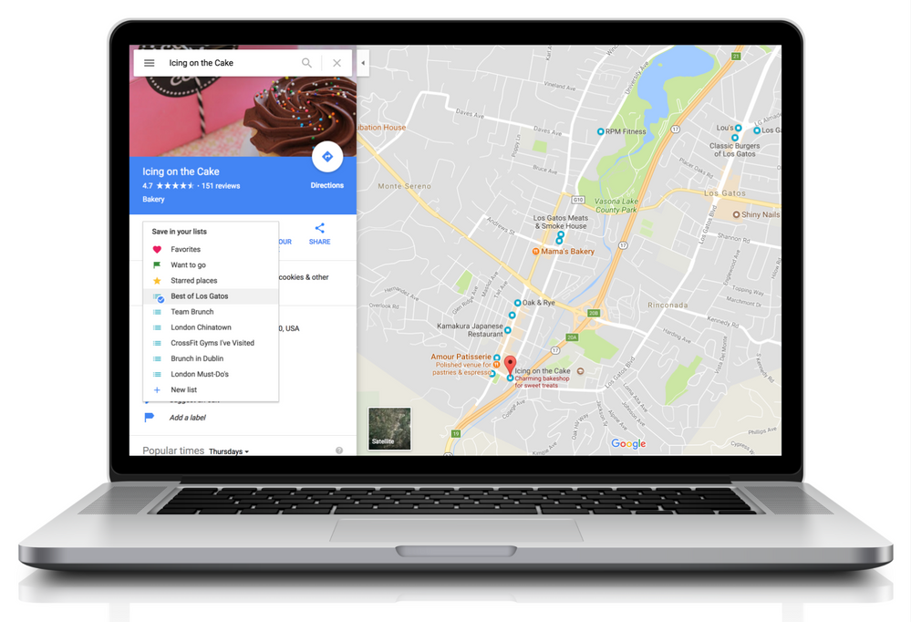
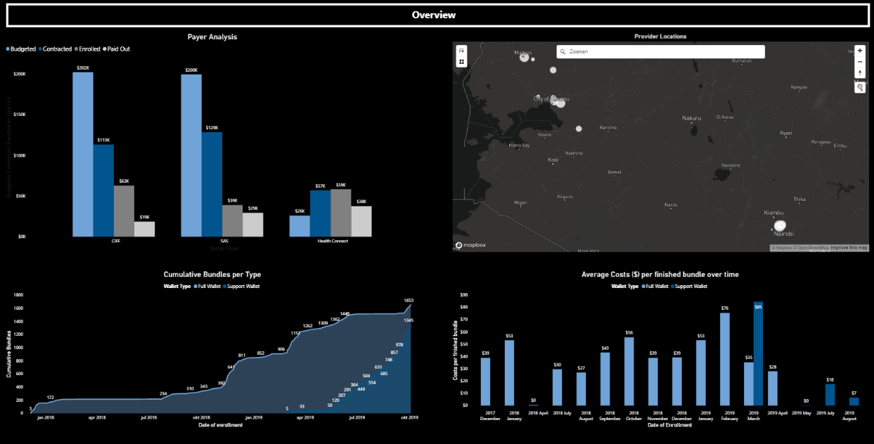
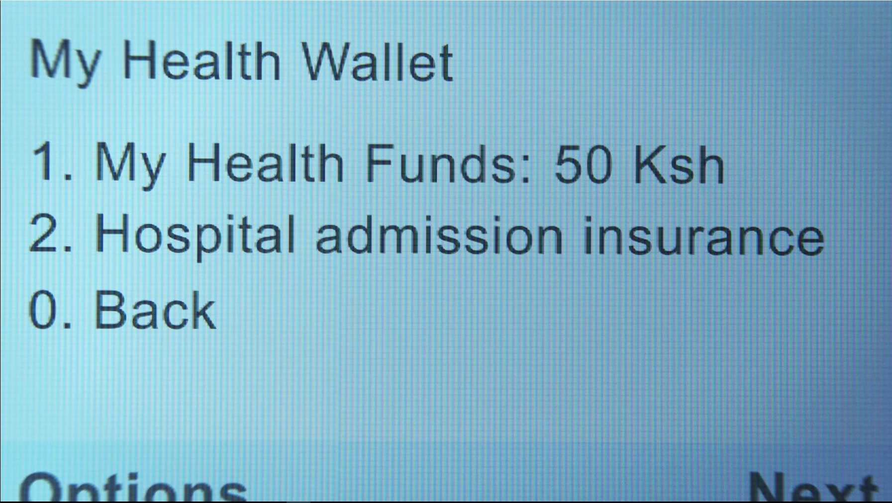
MomCare offers specific frontend tools for all parties involved built on a digital data-driven backend engine
Health wallet for patients
Showing entitlements and prompting alerts for clinic appointments
Dashboards to Payers
Reporting on financials, clinics and patients down to individual (anonymized) patient level
Patient tracker for providers
Showing treatment information and improvement suggestions over patients

Slide 7
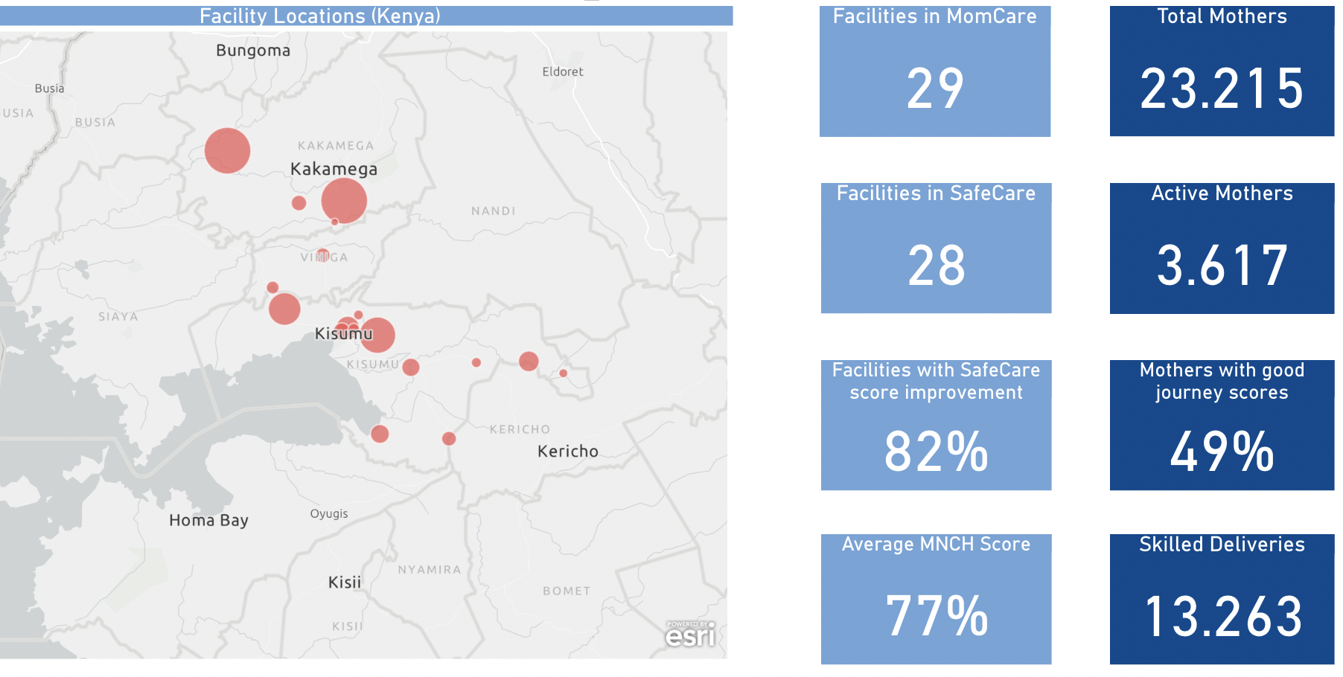
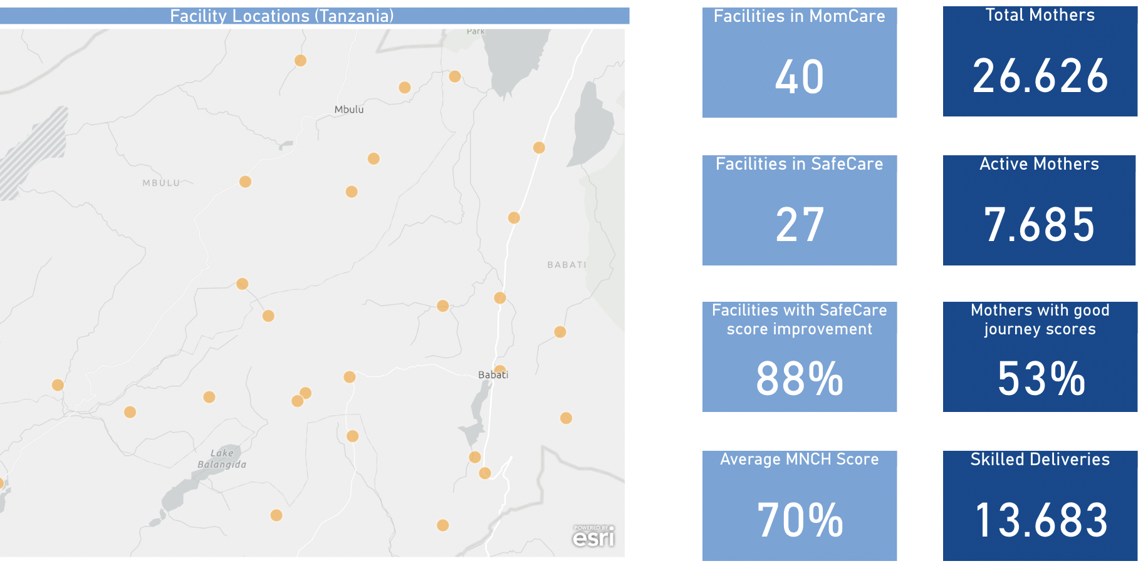
MomCare has supported the health journeys of ± 50.000 mothers with improved financing and journeys
Kenya
Tanzania

Slide 8
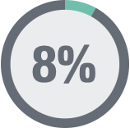
Risk stratification | 8 key metrics inform providers, payers and patients
The pregnancy journey
Caesarean / complications
Risk treatment
Delivery
ANC 4 + Birth plan
PNC
ANC 3
ANC 2
ANC 1
PNC, Immunizations
Enrolment
1. Equitable access
2. Timely enrolment
3. Timely reviews
4. Effective risk treatment
5. Birth planning
6. Delivery
7. Delivery complications
8. Outcomes
% Medical risk
% Teenager
% enrolment < 14
% enrolment < 28
% timely visits
% ultrasound < 28
Senior review or follow-up < 2 wk
% Called by clinic
% in network delivery
% Caesarean
% bad outcomes
Notes:
Many touch points and aspects are tracked, but 8 key metrics are the ones we currently optimize for

Slide 9
Risk stratification | Example of clinic engaging on high-risk mothers
Example clinic: BA Medical, Nairobi
+15%
+179%
+11%
93
92
+64%
+43%
70
9
Cohort 4
Cohort 12
Cohort 4
Cohort 12
Cohort 4
Cohort 12
Cohort 7
Cohort 12
Cohort 4
Cohort 12
Cohort 1
Cohort 12
1. Equitable access
2. Timely enrolment
3. Timely reviews
5. Birth planning
6. Delivery
7. Delivery complications
% Medical risk
% Teenager
% enrolment < 14
% enrolment < 28
% timely visits
% ultrasound < 28
% Called by clinic
% in network delivery
% Caesarean
Note: high Caesarean rate corresponds with clinic function as a ‘hub’ clinic in an area with limited secondary care facilities
Notes:
Improvement varies depending on the engagement of clinics, but virtually all clinics show a level of improvement. Note: Risk adjustment and subsidies are what drives improvement as much as the transparency on its’ impact

Slide 10
Risk stratification | Patient experience is a key element of the model
Empowerment
Experience / outcomes
Vulnerable groups
+38%
+34%
+50%
+40%
+36%
+41%
+67%
+51%
+18%
+61%
+147%
% of responses positive¹
Info about delivery signs
Info about pregnancy danger signs
Info about post partum danger signs
Info about breast feeding
Satisfaction
Treated with dignity and respect
Positive delivery experience
Felt supported (Always)
Challenges breast feeding (No)
Average for High-Risk mothers
Average for poor mothers
Outside network
MomCare
1. Source: Structured third-party telephone interviews, % answering question with ‘YES’ or score 4-5 out of 5; n= 3.837 ‘finished’ pregnancy journeys (20 weeks after delivery) of cohorts in Nariobi starting between November 2017 and November 2021. Participants in Western Kenya showing similar improvements (but measurements available only over shorter period of time due to roll-out schedule)
Notes:
Key areas of attention are level of support and breast feeding support. Critical to see that high-risk and poor mothers report a less positive baseline

Slide 11
MomCare journeys improve over time; its critical to unravel the key drivers
% of good MomCare journeys over time
% of good journeys e.g. that have ≥ 3 in journey score as per the number of cohorts providers participated in, with an additional split of the risk level of the women
59%
Key drivers
Learning curve per clinic (takes time to improve)
Case mix of new enrollments
Baseline low in Western and for teenagers
Cohort 5 decrease directly caused by enrolling Western
Engagement of facility
Use of patient journey application
Data dissemination workshops with clinicians &
Safecare technical assistance
Staff turnover and training
51%
50%
46%
45%
38%
38%
35%
34%
22%
2%
1%
2%
0%
2
3
4
5
6
7
8
9
10
11
% good score
% high risk
% medium risk
% low risk
# cohorts participating
* Data as per 09-03-22

Slide 12
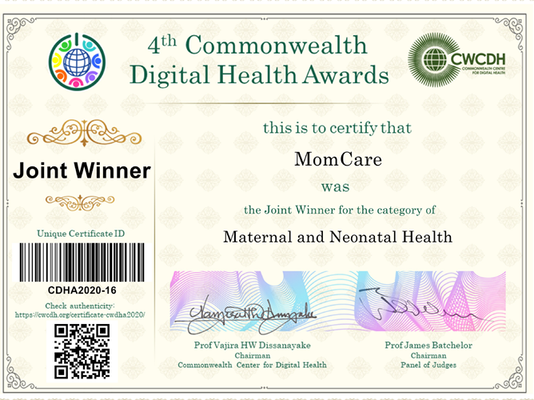
Thank you
n.spieker@pharmaccess.org
Winner Commonwealth Awards 2020

