Slide 1
Stroke pathway pilot
Tiina Sats, Terje Peetso, Vesa Komssi
2nd November 2022

Slide 2


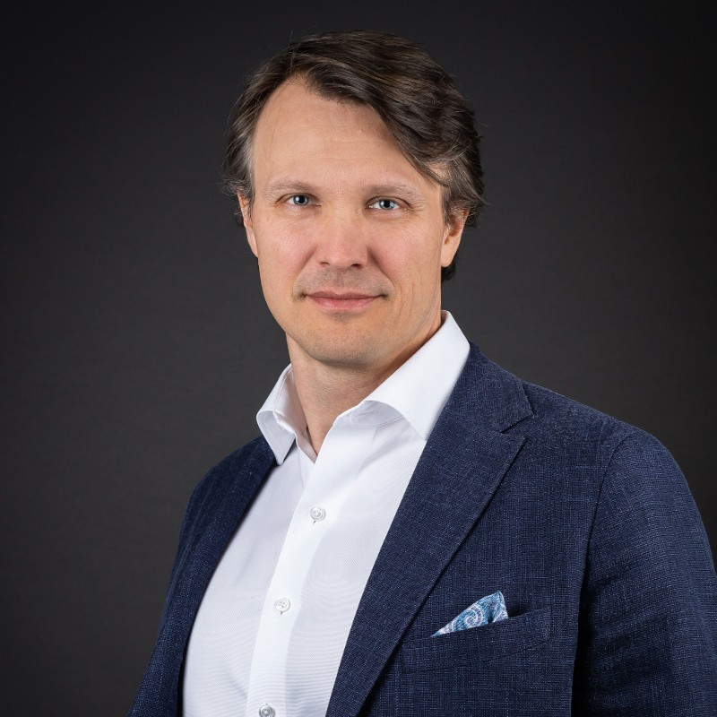
Tiina Sats
Head of Department, Estonian Health Insurance Fund
Project lead
Terje Peetso,
MD, Member of the Management Board, North Estonia Medical Centre (NEMC)
Member of the preparatory team → steering group
Introductions
Vesa Komssi,
Executive vice president, Nordic Healthcare Group
Project director for data collection and visualization
Notes:
Estonian Health Insurance Fund is a single payor in Estonian health care system covering the costs of health services. The vision of EHIF is to create a sense of security for members of society when they face health problems and seek medical care, so as to increase the number of healthy life years. Leading the pilot right from the start, first meetings. with neurologists. EHIF over 10 years.
Tertiary level hospital, one of the three biggest in Estonia. Largest hospital in Estonia. Specialisation in internal diseases, now management positions for the past 20 years.

Slide 3
Agenda
Background of the pilot
Outcomes collection and visualization
Results
Way forward

Slide 4
Background of pilot

Slide 5


Slide 6
Specialist saw the need for change
Centrally coordinated
(top-down):
Defining the pathway
Identifying the problems
Agreeing what outcomes should be measured
Providing IT
Developing a new payment method
Locally implemented (bottom-up):
Organizing the pathway
Implementing outcomes collection

Slide 7
Why this pilot has been important from hospital point of view?
Personalised medicine – value based healthcare – patient centric healthcare
Our principles for innovation:
  Structure
  Processes
  Competencies
  Agreed objectives
  Motivation
Challenges:
Advocacy
Benefits
Resource
Digital interoperability
Data protection/Cybersecurity
Analysis
Benefits for doctors/nurses:
Better relationship
Personalised pathway
Quality indicator
Comparison with ohter HCP-s
Analysis and input to guidelines
Benefits for patients/relatives:
Engagement
Responsibility
Improved awareness
Better results

Slide 8
Outcomes collection and visualization

Slide 9
Outcomes collection based on ICHOM Set of patient centred outcome measures for stroke
https://connect.ichom.org/patient-centered-outcome-measures/stroke/

Slide 10







Outcomes collected through Philips platfrom and costs from EHIF
Hospitals / patients
Patient reported outcomes (PROMs) measurement
platform
Dashboard for outcome benchmarking
Cost data

Slide 11
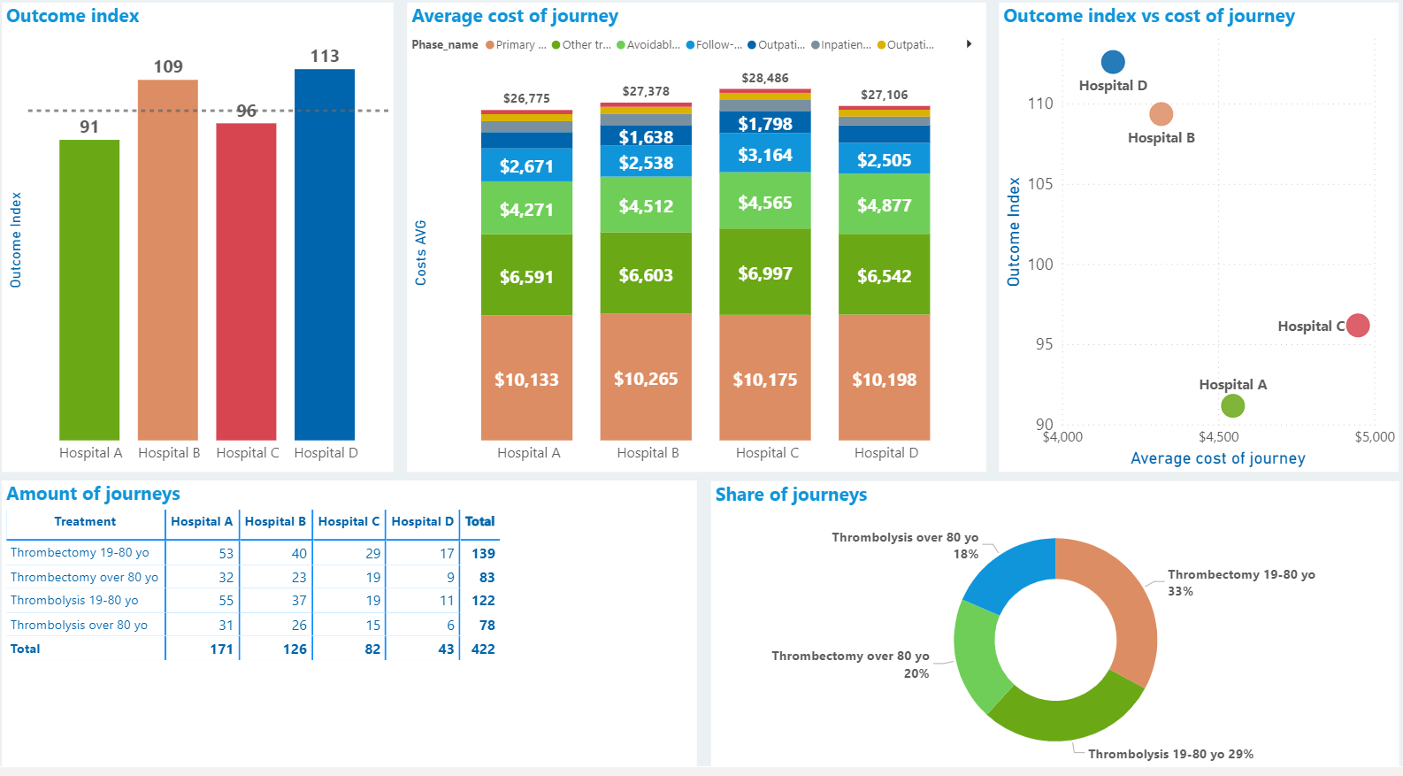
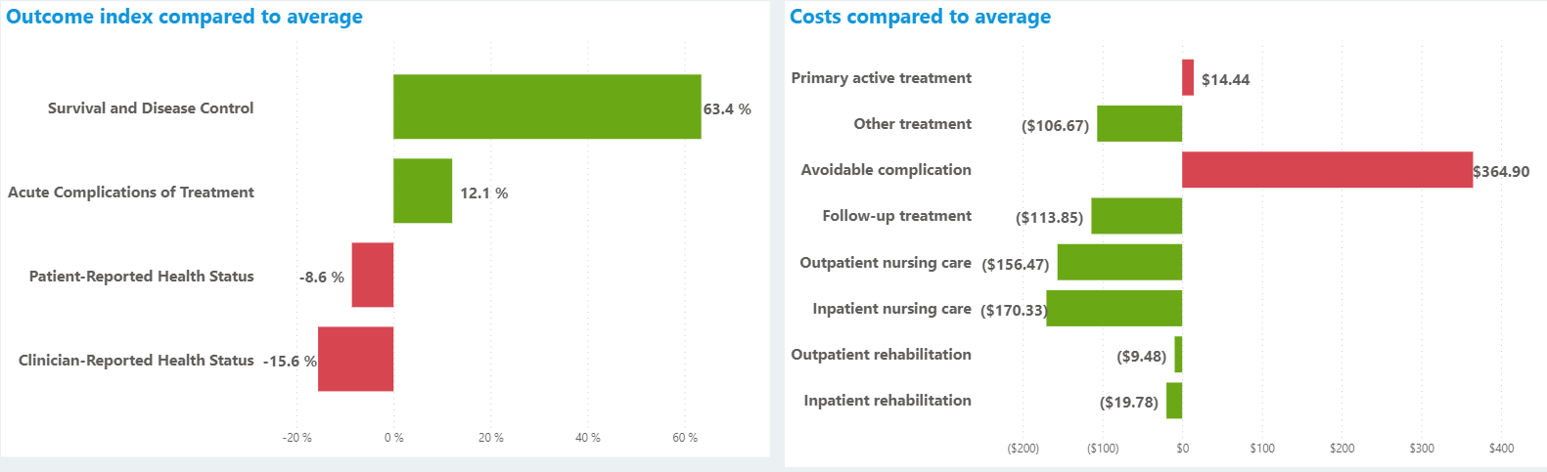
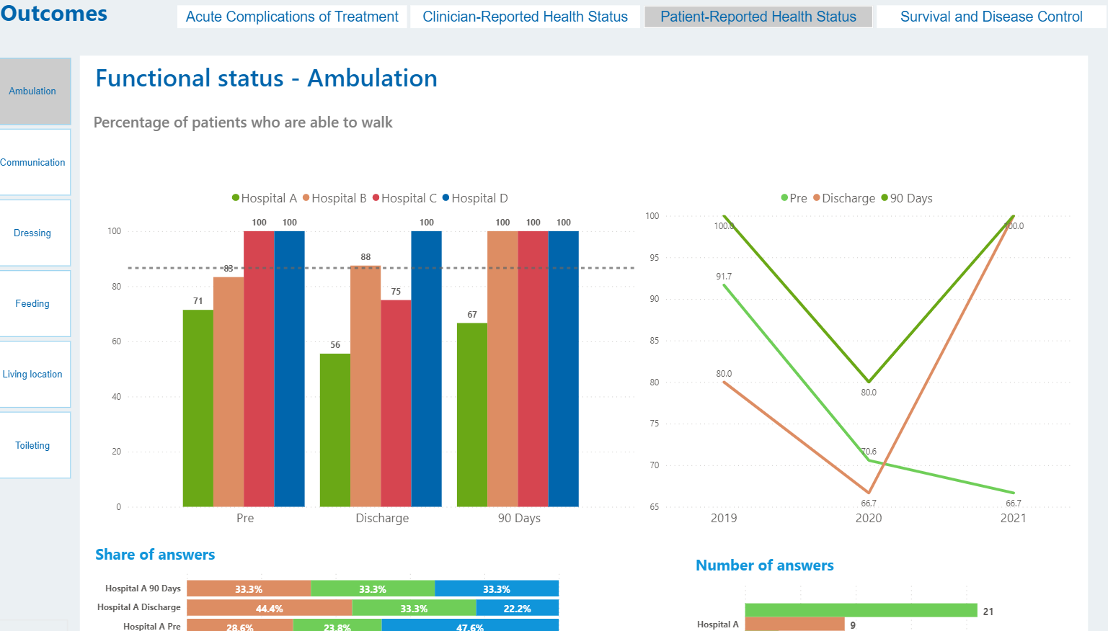
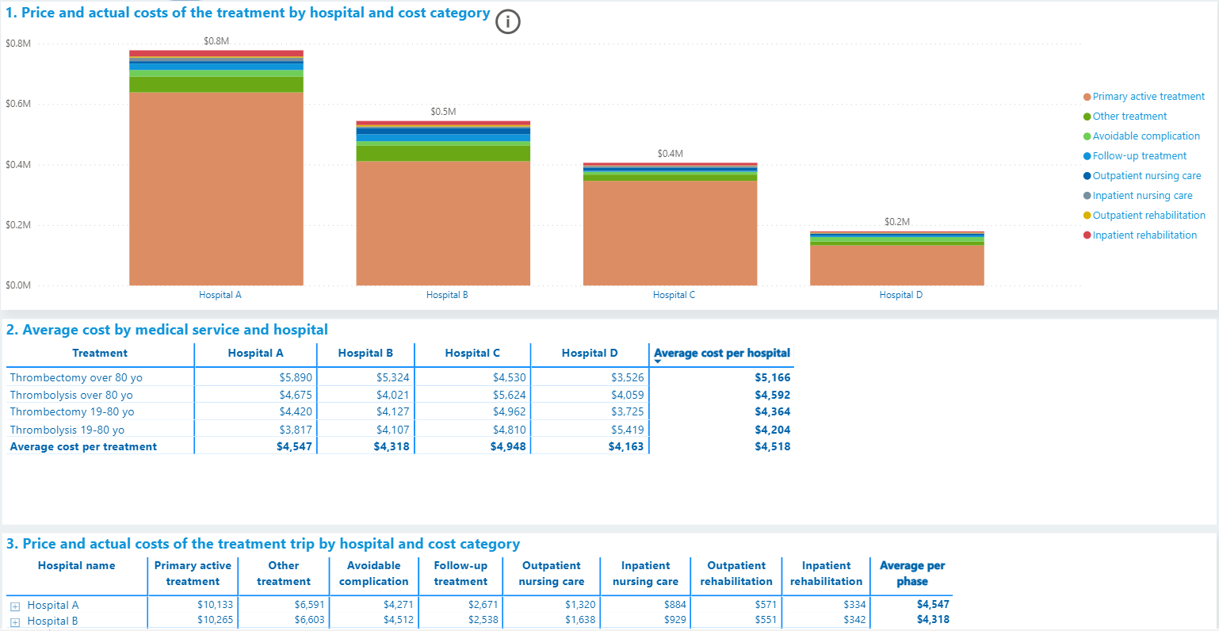
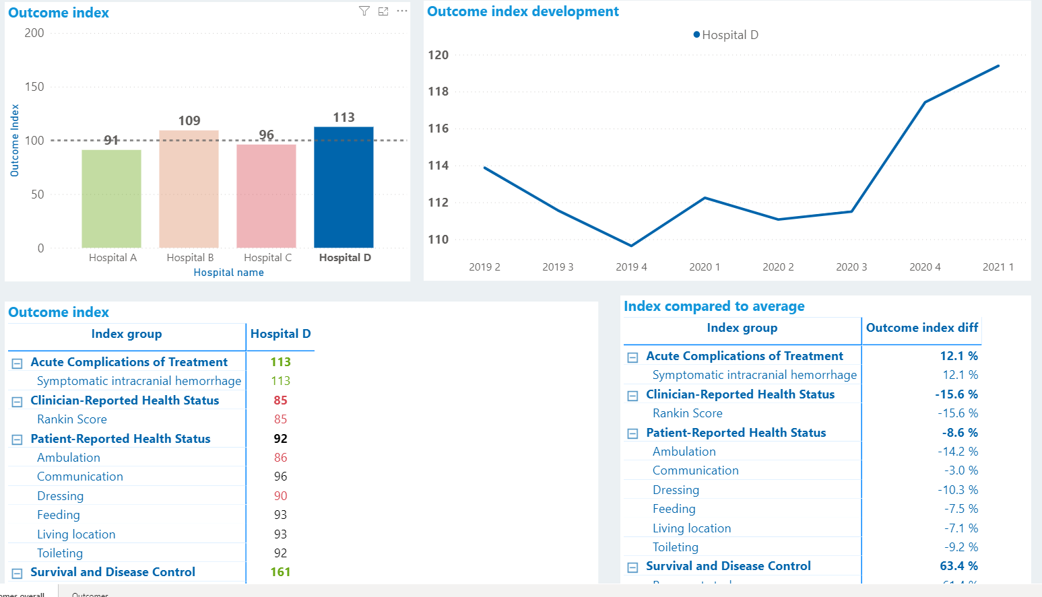
Outcomes collection based on ICHOM Set of patient centred outcome measures for stroke
Summary view
Overall view of both outcomes and costs together
Deviation analysis from the hospital average
Outcomes views
Cost view
Development of NHG outcome index over time
Outcomes index dimensions and difference to average
Deep dive view on specific outcomes dimensions
Total cost by care pathway step per hospital
Possibility to deep dive to actual costs per patient

Slide 12
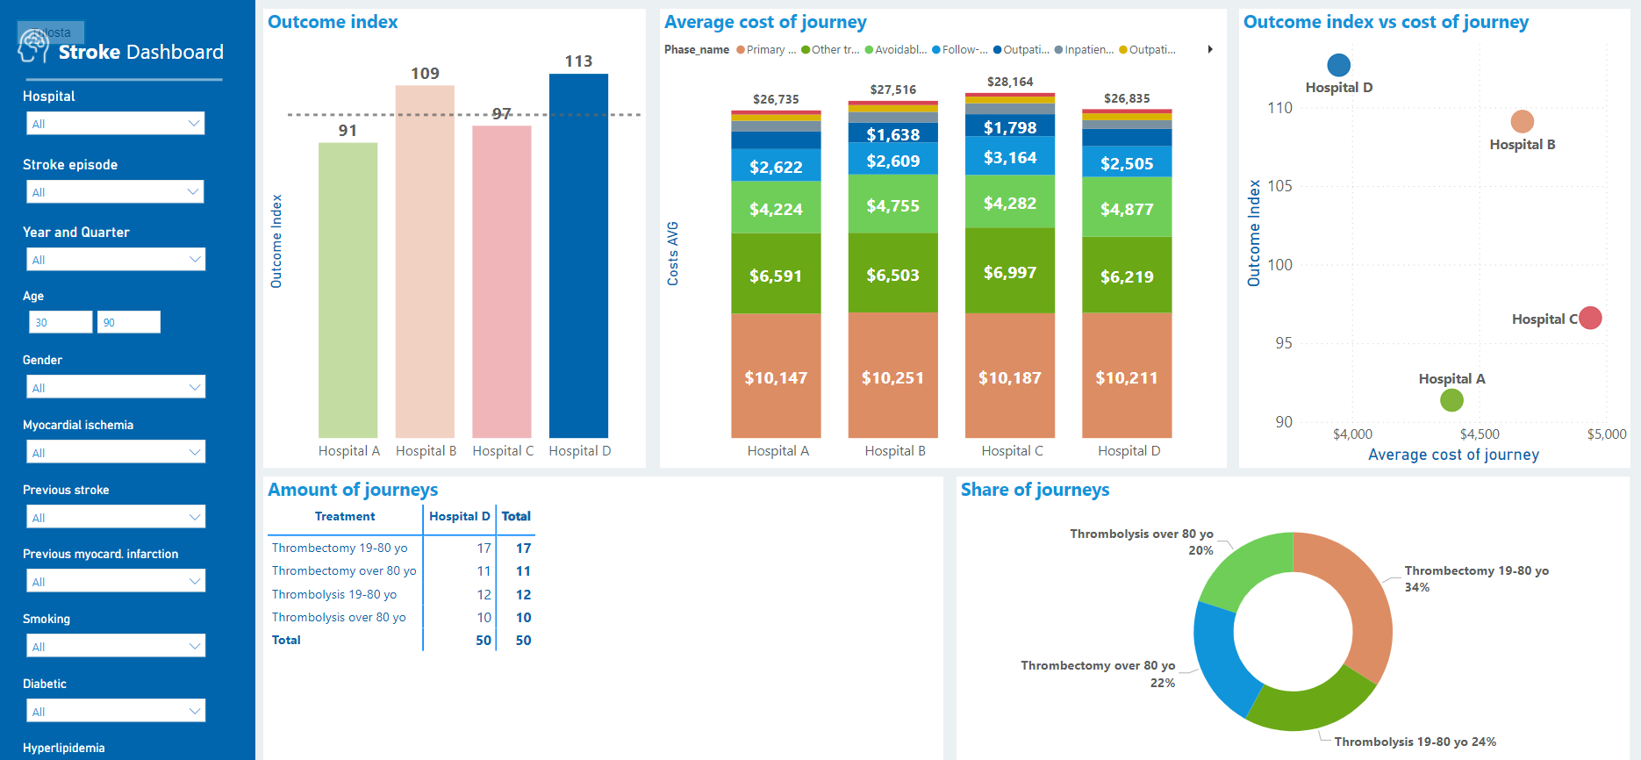
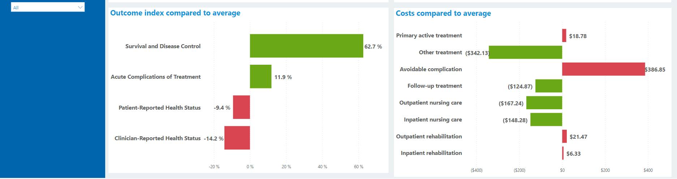
Overview of NHG stroke VBHC benchmarking dashboard
Overall view of both outcomes and costs
Several possibilities for filtering the results
NHG outcome index that combines different dimensions of ICHOM standard set
Deviation analysis that shows where a hospital is scoring well and room for improvement
Possibility to case mix adjust the results

Slide 13
Results

Slide 14
Results show significant differences in outcomes and costs between hospitals
Outcomes and costs by hospital
Key results
Outcome index*
Hospitals A and C have higher outcomes but at the same time also lower costs than hospitals B and D
  Higher outcomes mainly due to better patient reported outcomes and fewer new strokes
  Lower costs attributable to lower acute care and rehabilitation costs
Despite case-mix adjustment based on stroke severity, differences in hospital profiles (regional vs. central hospital) explain especially differences in costs
Despite lower overall outcomes, hospital D has the best survival rate
A
C
D
B
Full care chain cost €*
= Central hospital**
= Regional hospital
*Stroke severity adjusted results. **Central hospitals do not offer thrombectomy

Slide 15
Pilot in overall was successful
One year mortality rate (%)
Use of rehabilitation (% patients 6month)
Intervention group
Control group
Intervention group
Control group
The pilot was associated with significantly decreased risk of mortality.
Case mix adjusted results showed similar difference
There was an unexpected effect of the lower mortality - the intervention group had lower quality of life.
The pilot was associated with significantly increased use of rehabilitation.
Case mix adjusted results showed similar difference
The pilot was also associated with significantly increased number of secondary prevention appointments

Slide 16
Lessons learned from the pilot
Need to agree on a national stroke pathway standard. How much flexibility should be in it to have also personalised medicine?
Double entry of case-mix data
Most of the data is collected by phone
The data is not used in the work process
Bundled payment alone may not stimulate cooperation
Access to data (data standards and interoperability)

Slide 17
Way forward

Slide 18
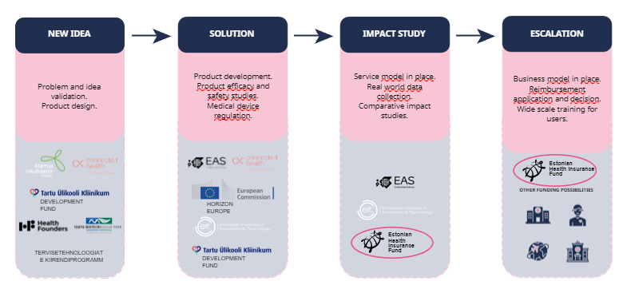
What is the way forward?
National level
Hospital level
  Hip and knee replacement pathway
  Innovation fund to support similar projects
  Patient pathways at the NEMC
    Breast and prostate cancer
    Colon cancer
    Chronic obstructive pulmonary disease
    Transcatheter aortic valve implantation
    Emergency psychiatry
    Foot surgery and rehabilitation
    Endoscopy
  Access to data
  Digital health literacy
  Discussions on whether we should provide an outcome collection and visualization IT solution for all providers

Slide 19




For better health!
terje.peetso@regionaalhaigla.ee
tiina.sats@haigekassa.ee
vesa.komssi@nhg.fi

