Slide 1



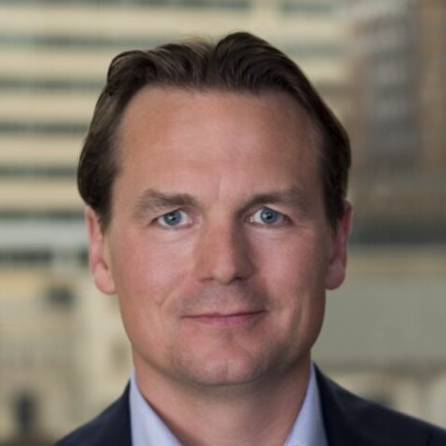
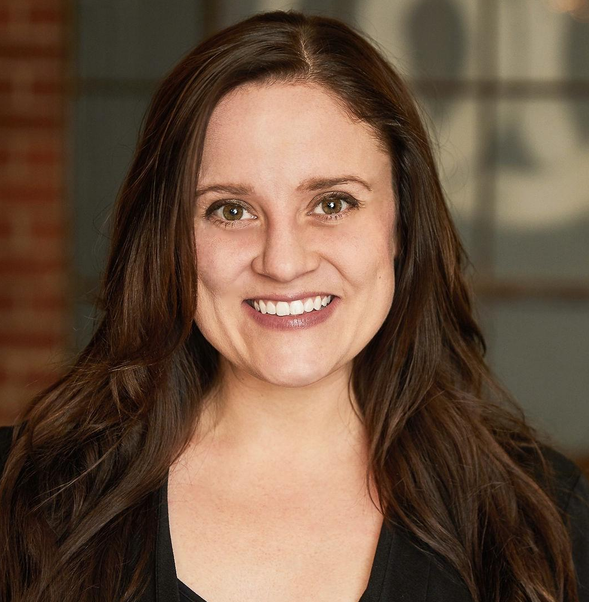
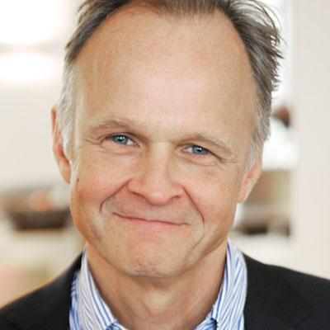
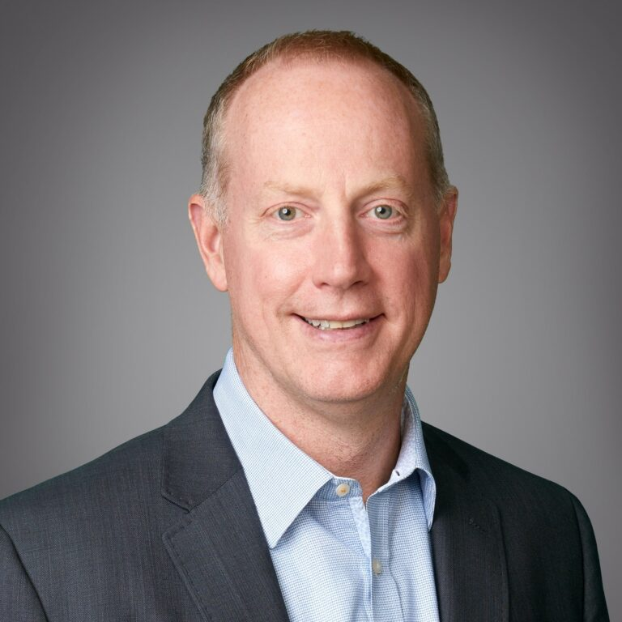
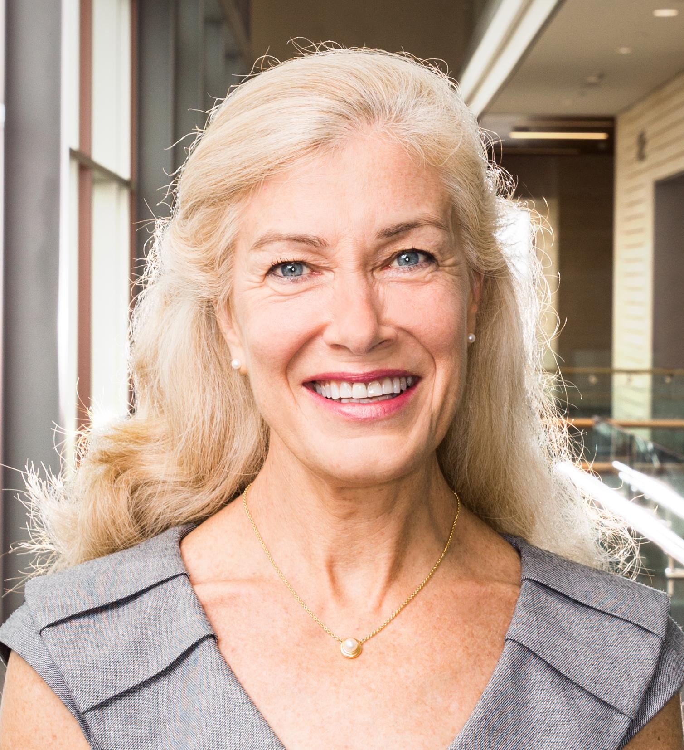
PLENARY SESSION
ICHOM Fireside Chat
3 Nov 2022 | 16:00 EDT
Dr. Stefan Laarson
Independent advisor -
Healthcare & Life Sciences,
Co-founder & Board Member, ICHOM,
Sweden
Patrick Conway
CEO - Care Solutions,
Optum
USA
Prof. Elizabeth Teisberg
Cullen Trust Distinguished University Chair in Value-Based Care - Dell Medical School; Executive Director - Value Institute for Health & Care - the McCombs School of Business University of Texas at Austin
USA
Dr. Maarten Akkerman
Board Member, Diabeter; Head Medical Affairs, VBHC North-West Europe, Medtronic,
The Netherlands
Kellie Paich, M.P.H.
Global Director, Clinical Quality & Survivorship, Movember
-

