Slide 2
STRATEGIC FOCUS THAT SUPPORTS THE USE OF OUR SETS AND HELPS DRIVE CHANGE
Demonstrate the value created by existing Set use and new learning collaboratives, stepping up awareness of ICHOM
Build and grow the coalition for outcomes measurement, strengthening the global VBHC community
Provide solutions for fast and easy adoption of Sets through partnerships and adaptation of Sets
Strengthen our key relationships with organisations who support our mission now and looking ahead over the next decade
p
1-3 November 2022 | Boston Park Plaza, Boston
conference.ichom.org

Slide 3
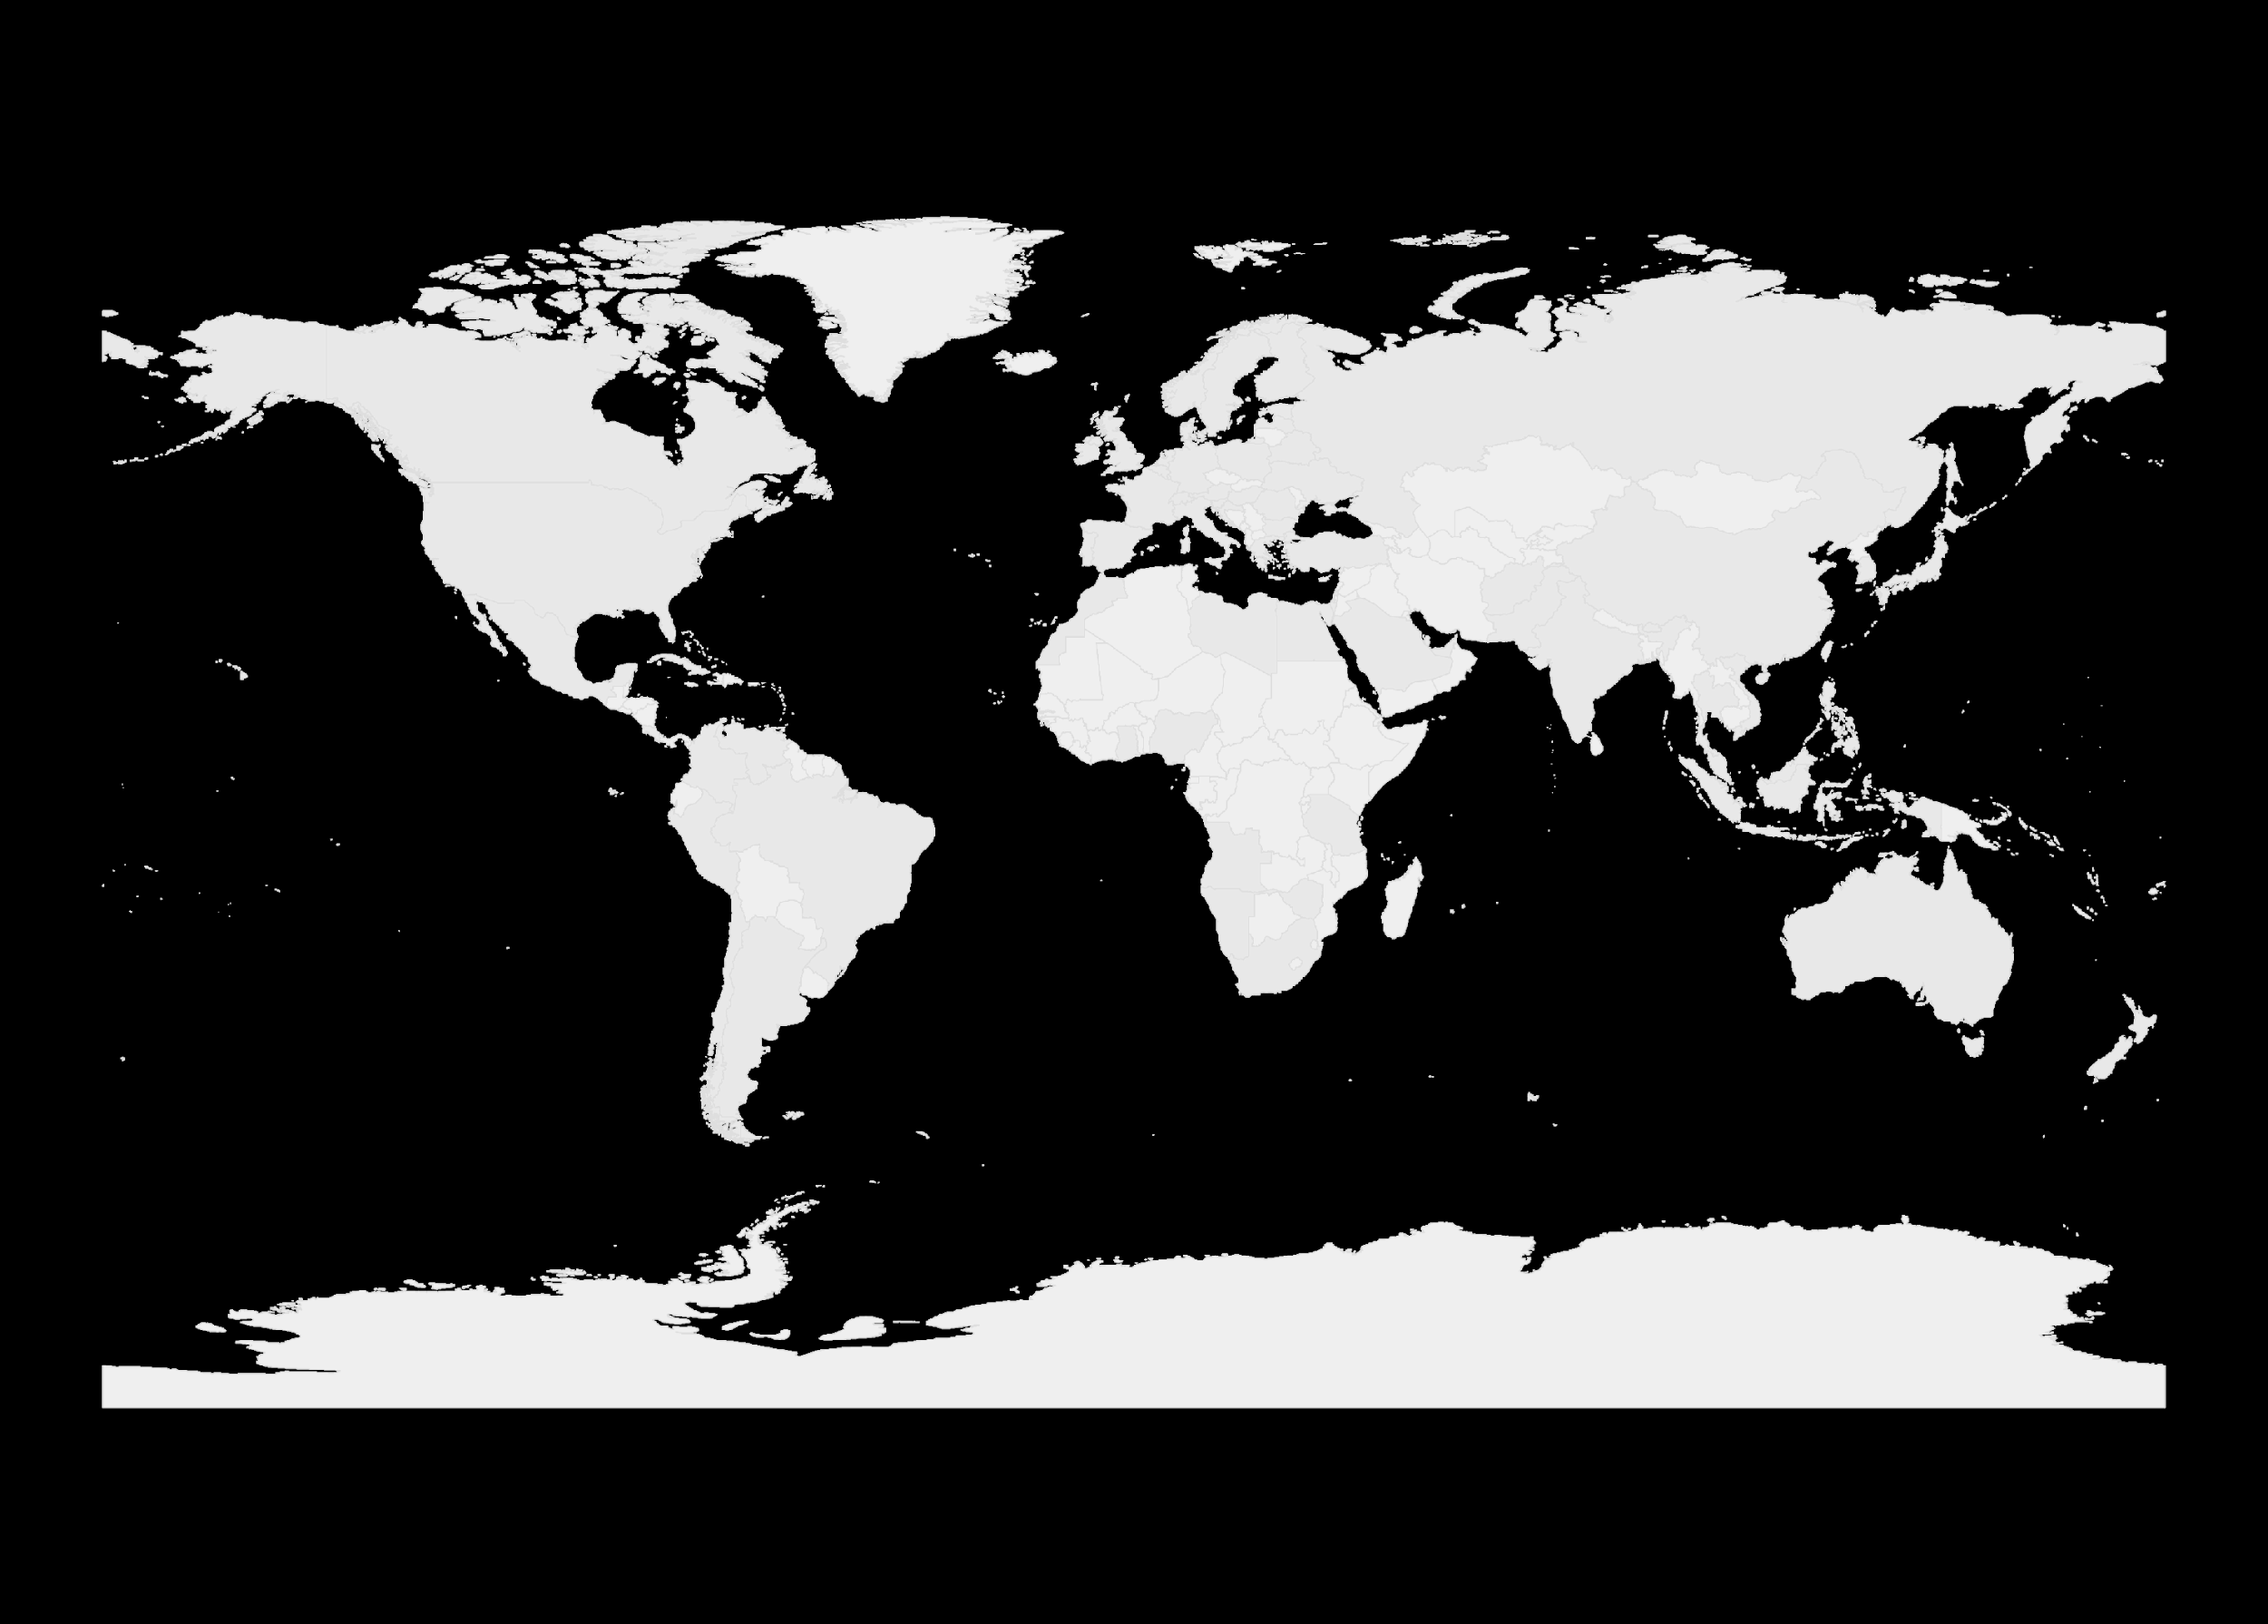
ICHOM HAS DEVELOPED 44 SETS TO DATE, COVERING 57% OF GLOBAL DISEASE BURDEN
60
50
40
30
20
10
0
Heart Valve Disease
Venous Thromboembolism
Eating Disorders
Neurodevelopmental Disorders
Epilepsy
HIV / AIDS
Obesity (TBD)
Myeloma (TBD)
Trauma (TBD)
28. Atrial Fibrillation*
29. Adult Health*
30. Pediatric Health*
31. Congenital Heart Disease*
32. Hand & Wrist Osteoarthritis*
33. Oral Health*
34. Addiction*
35. Personality Disorder*
36. Psychotic Disorders*
37. Preterm and Hospitalized Newborn Health*
38. Pediatric Depression & Anxiety*
39. COVID-19*
40. Autism Spectrum Disorders
% GBD (DALY)
Chronic Kidney Disease*
Hypertension*
Inflammatory Arthritis*
Congenital Upper Limb Anomalies*
Pediatric Facial Palsy*
Diabetes (I &II)*
Breast Cancer*
Dementia*
Heart Failure*
Pregnancy and Childbirth*
Colorectal Cancer*
Older Persons*
Overactive Bladder*
Craniofacial Microsomia*
Inflammatory Bowel Disease*
Localized Prostate Cancer *
Lower Back Pain *
Coronary Artery Disease *
Cataracts *
Parkinson’s Disease*
Cleft Lip and Palate*
Stroke *
Hip and Knee Osteoarthritis*
Macular Degeneration*
Lung Cancer*
Depression & Anxiety*
Advanced Prostate Cancer*
Percentage of global disease burden coverage is based on average from Global Burden of Disease Study 2019 (IHME) and World Health Organization GHO 2019.
2013 - 2014
2015 - 2016
2017 - 2018
2019 - 2021
2022- 2023
p
1-3 November 2022 | Boston Park Plaza, Boston
conference.ichom.org

Slide 4
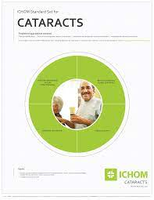
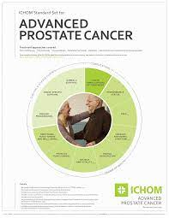
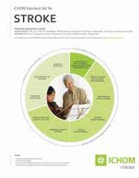
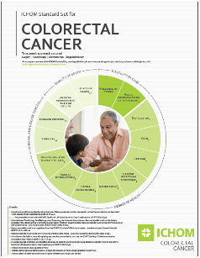
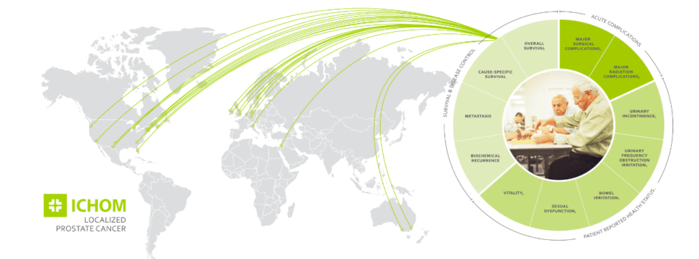
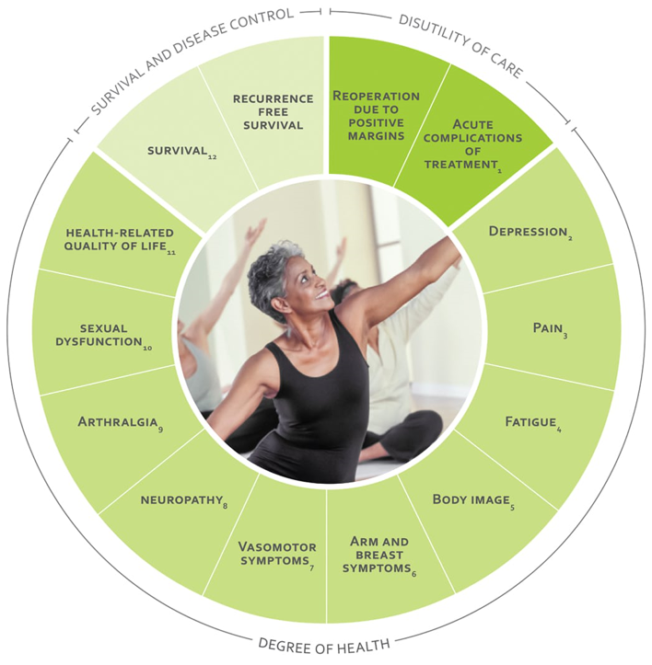
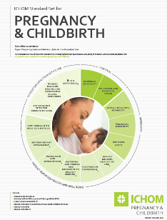
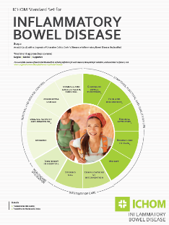
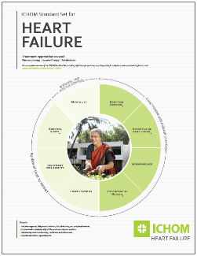
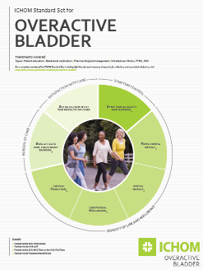
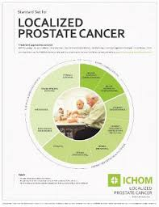
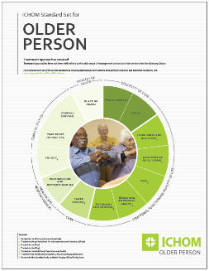
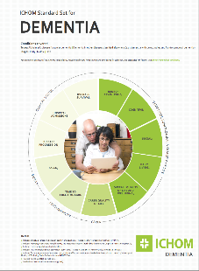
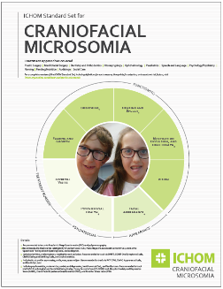
ICHOM LEARNING COLLABORATIVES
p
1-3 November 2022 | Boston Park Plaza, Boston
conference.ichom.org

Slide 5
Thank you!
p
1-3 November 2022 | Boston Park Plaza, Boston
conference.ichom.org

